Slide 1
Thickness Planer
Thanks to Tom Bockman of
Prescott, Arizona for major parts of slide show.

Slide 2
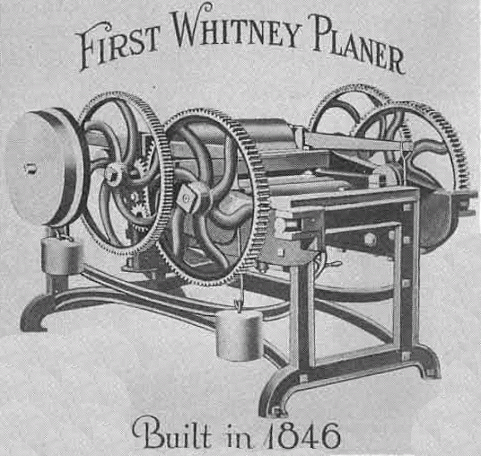
The Thickness Planer
The planers purpose is to smooth boards while creating an even thickness, but large machines really didn’t work very well before electricity. Early machines like this were also safety nightmares.
Huge gears and weights were needed to run this old timer. Notice how much of the planer is open… unguarded.

Slide 3
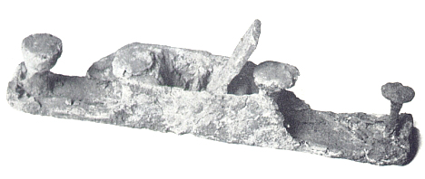
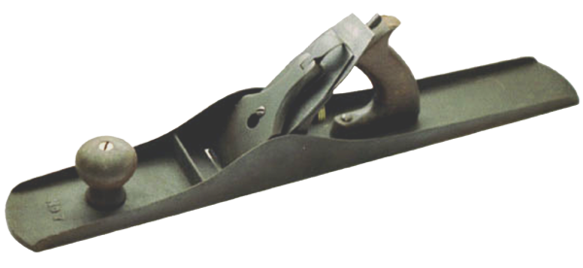
The hand plane goes back thousands of years.
This rusted relic is a Roman era hand plane.
The jointer plane’s long base glides over irregularities to produce a very straight edge.
Compare to a modern day hand plane.
Though most surfacing is now done with jointers and planers, hand and portable power planes remain valuable to any woodworker.

Slide 4
Squaring sequence
Follow this sequence to make square lumber.
1
Plane off one face.
3
Plane the opposite face.
Jointer
Thickness Planer
Flip down
Flip up
Flip over
2
Plane off one edge.
4
Saw off the opposite edge making it parallel to the first.
Jointer
Tablesaw

Slide 5
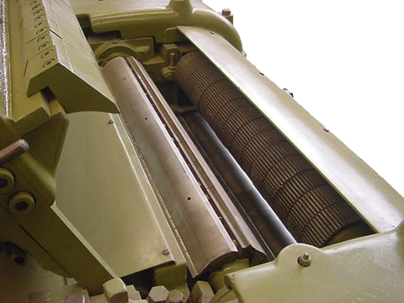
Safety?
The planer is relatively safe with most moving parts completely under cover.
Infeed rollers
Cutter head

Slide 6
The Thickness Planer… planes the surface of boards.
OUTFEED
INFEED
Chipper
OUTFEED TABLE
INFEED TABLE
Thinner stock requires the use of a backer board.
Change the thickness by raising or lowering the table. One turn of the front wheel equals 1/16th of an inch.

Slide 7
comments about grain direction

Slide 8
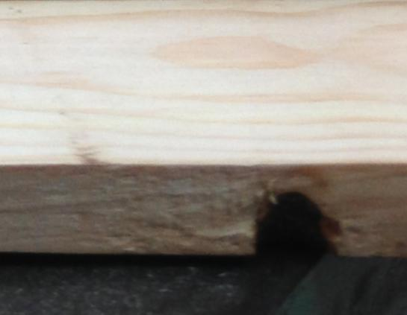
No nails, screws or staples! Remove loose knots before planing.

Slide 9
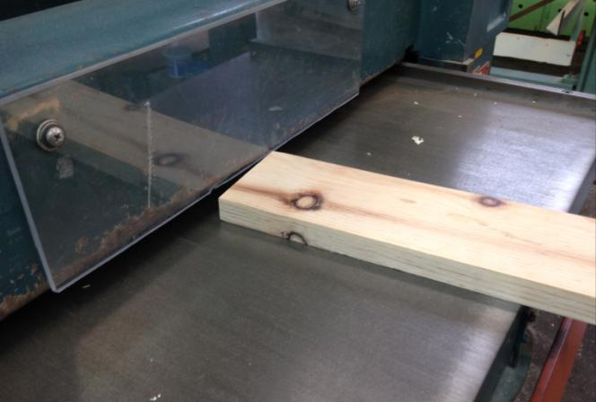
Board must be lower than this plastic. Measure or crouch down and look at board and rollers inside planer.

Slide 10
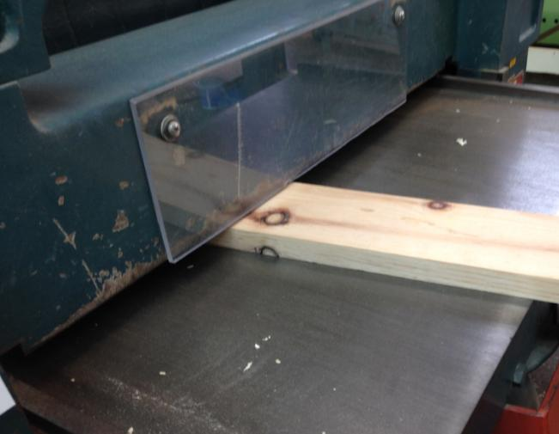
DON’T EVER PUT FINGERS INSIDE MACHINE!

Slide 11
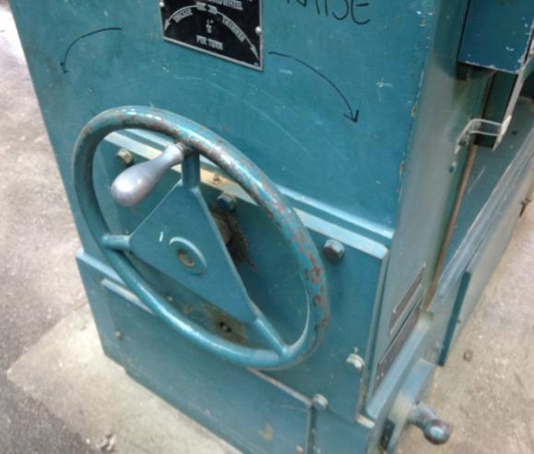
Handle to raise and lower table.

Slide 12
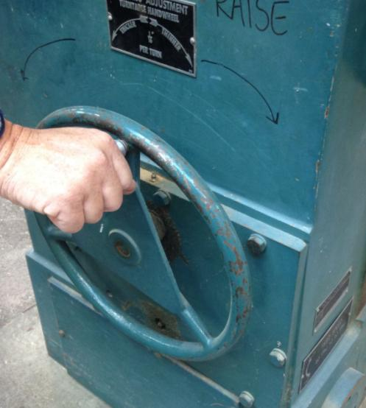
One turn = 1/16 inch. No more than one turn each pass.

Slide 13
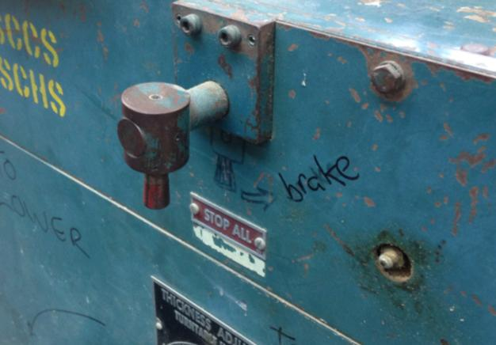
Brake in off position.

Slide 14
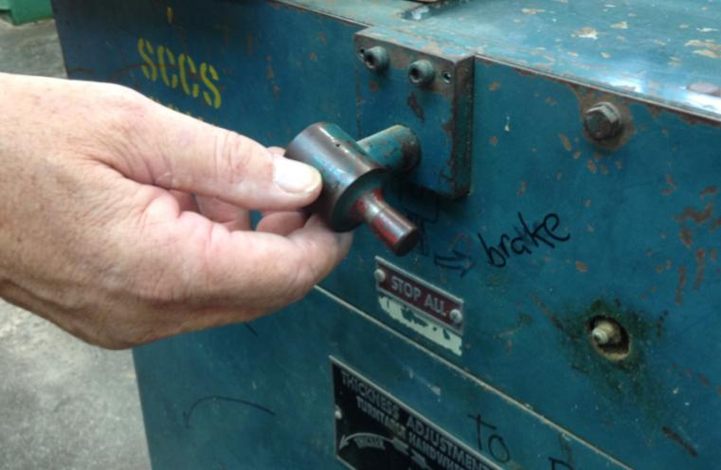
Turn off planer then turn brake to stop rollers & cutter from turning.

Slide 15
Return brake to off position.

Slide 16
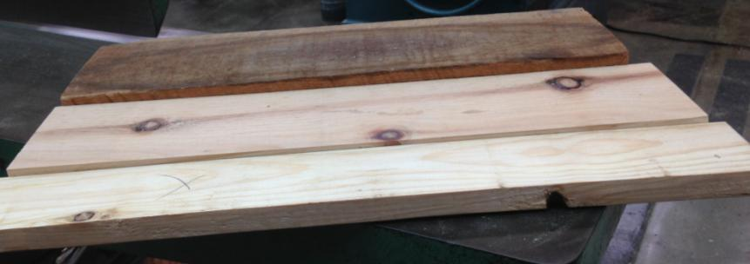
If you want all three boards to be the same thickness, which board do you start with?

Slide 17
For boards of different thicknesses. 1. Start with the thickest board. 2. Plane it until it is the same as the next thickest board. 3. Plane both these boards together until they are the same as the third board. Etc.

Slide 18
Safety Rules
1. Wear safety glasses.
2. The minimum size that can be planed is
1/4" x 14". Don't attempt to plane anything shorter.
3. Boards thinner than ¼” must have a backer board underneath them.
4. Turn on the dust collection system.
5. Never plane lumber containing nails, screws or staples. Look carefully at the board before planing.
6. Depth is the only adjustment made with
the machine running.

Slide 19
7. Normal cuts are one turn of the wheel which = 1/16"
8. Never change the thickness while the stock is in the planer.
9. Glued up projects must dry 24 hours before
running.
Loose knots should be removed.
Allow the machine to reach full speed
before feeding stock.
12. Keep hands clear of feeding stock.
13. Stand to one side.

Slide 20
14. Never look into the running machine.
If a board gets stuck, turn off the machine.
Lower the table. Get the teacher.
Do not try to force boards through and
NEVER reach into the machine with your hands.
16. When you are finished, turn off the machine and use the brake to stop it.
17. Return all adjustments to normal. Return the brake to the off position.
18. Clean up after yourself.

