Slide 1
Table Saw (Circular Saw)
Thanks to Tom Bockman for bulk of this slide show.

Slide 2
Circular Saws
There was a time when two man saws did most of the cutting.

Slide 3
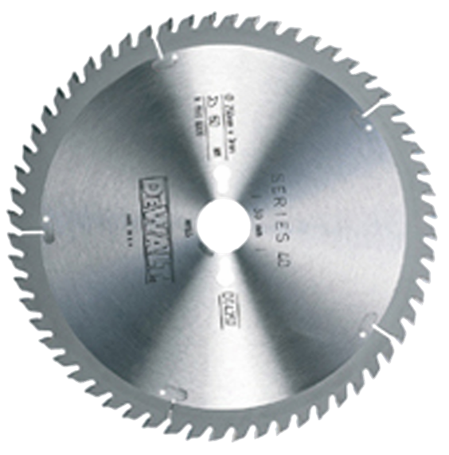
The circular revolution
The circular saw blade was invented by a Shaker woman over one hundred years ago. She came up with the idea as she sat at her spinning wheel where she could see the men laboring hard at sawing timbers.

Slide 4
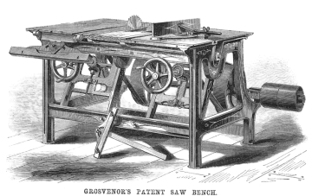
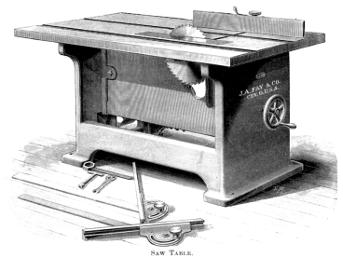
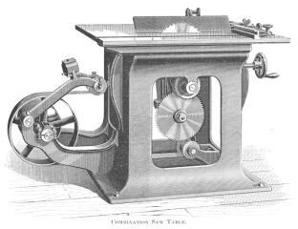
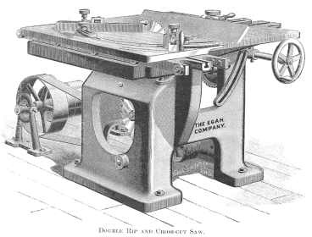
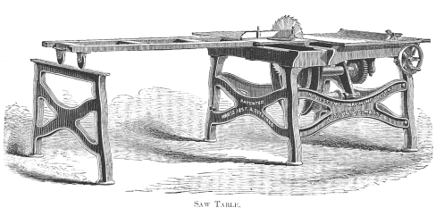
1850’s
Early steam driven machines.

Slide 5
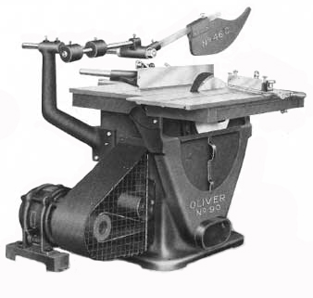
This belt driven industrial relic was advertised as “Safely Guarded”, well ahead of its time.
Even the belt system is covered.

Slide 6
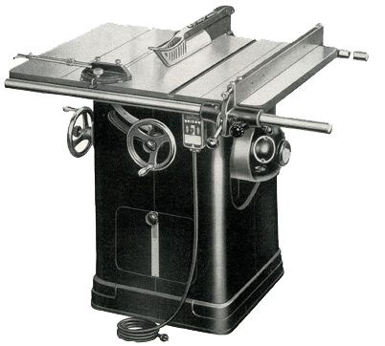
The 1950’s Delta Unisaw has most of the features familiar to us.
Only recently did we sell one of these to get a “SawStop” table saw in its place.

Slide 7
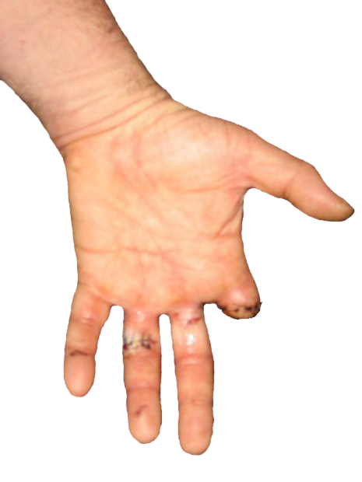
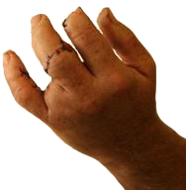
Safety
Concentrate…
The table saw is the central work horse of every woodworking shop. It’s heavy use makes it one of the more important safety concerns.
Keep your left hand behind the cut!
… don’t amputate!

Slide 8
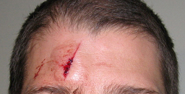
Kickback and the Rule of Rectangle
For safety during cutting, the long side of the rectangle always goes to the fence!
The result of kickback
Taking the blade speed into account, an object can be shot back at 120 miles per hour.
Shape is more important than grain direction.

Slide 9
The long side of the rectangle is always more stable, so regardless of grain direction, the long side should always be used to guide the board.
The Rule of Rectangle says…
The long side always goes to the fence!
Move the wood/blade in the direction that increases stability.
Stability is the key to avoiding kickbacks.
Rip cutting
Crosscutting
Less stable
Rule of rectangle reduces kickback.
More stable

Slide 10
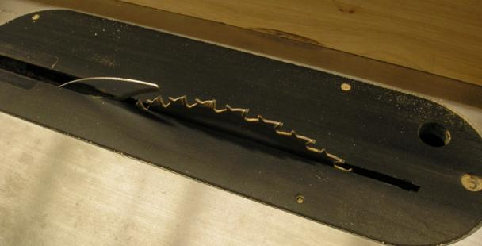
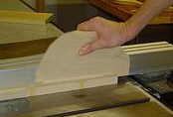
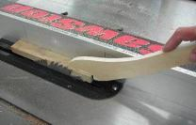
These are made from scrapwood.
Ride the push block just inside the blade
Fence
Push block
Splitter
On the tablesaw, keep the push block closer to the blade than the fence.
Push stick
Along with the splitter, this steers the wood straight.
Leave the left side alone. Touching it can pinch it to the blade and send it flying while sending your hand into the blade. Combining the rule of rectangle with a splitter, proper push stick placement and not passing the blade with the left hand, kickbacks will be rare.

Slide 11
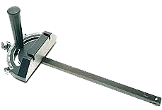
The Miter Gauge
When using the miter gauge to crosscut a board, it’s usually not a good idea to use the rip fence at the same time.
The offcut, the loose piece freed by the cut, can when it get trapped between the blade and the fence and kickback.
Don’t trap the wood.

Slide 12
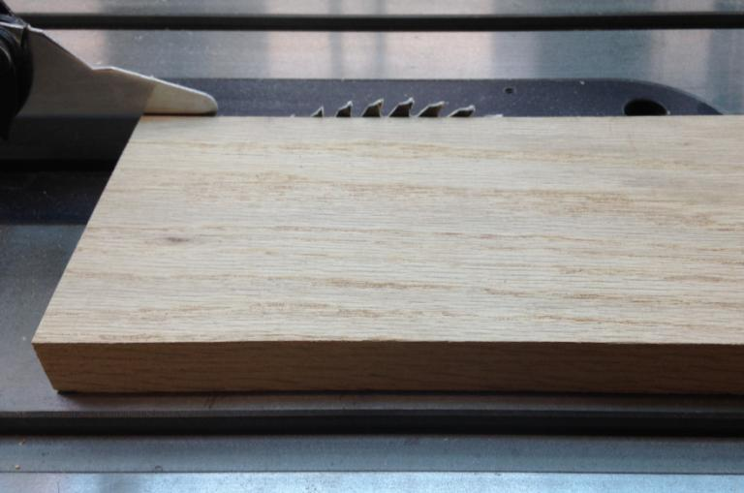
Set the blade with the teeth just above the wood (≈ 1/8 inch).

Slide 13
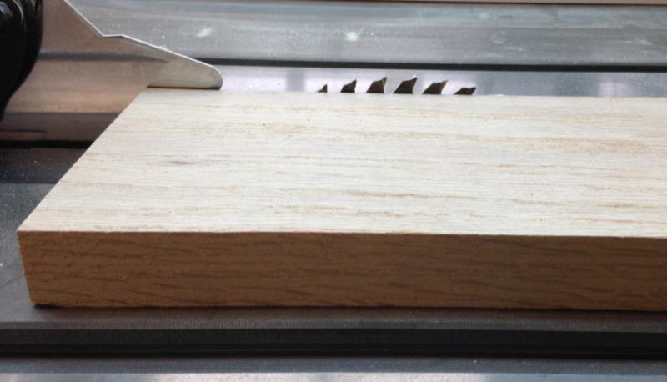
Set the blade with the teeth just above the wood (≈ 1/8 inch).

Slide 14
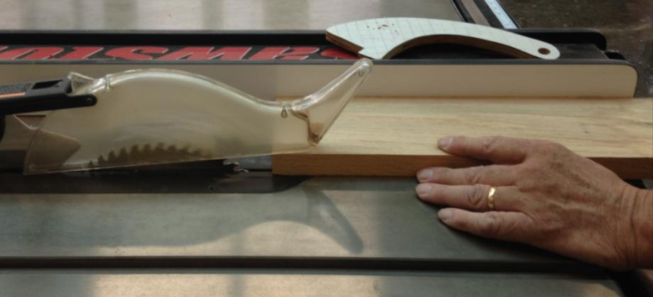
Plant your left hand on the edge of the table. It does NOT travel with the wood.

Slide 15
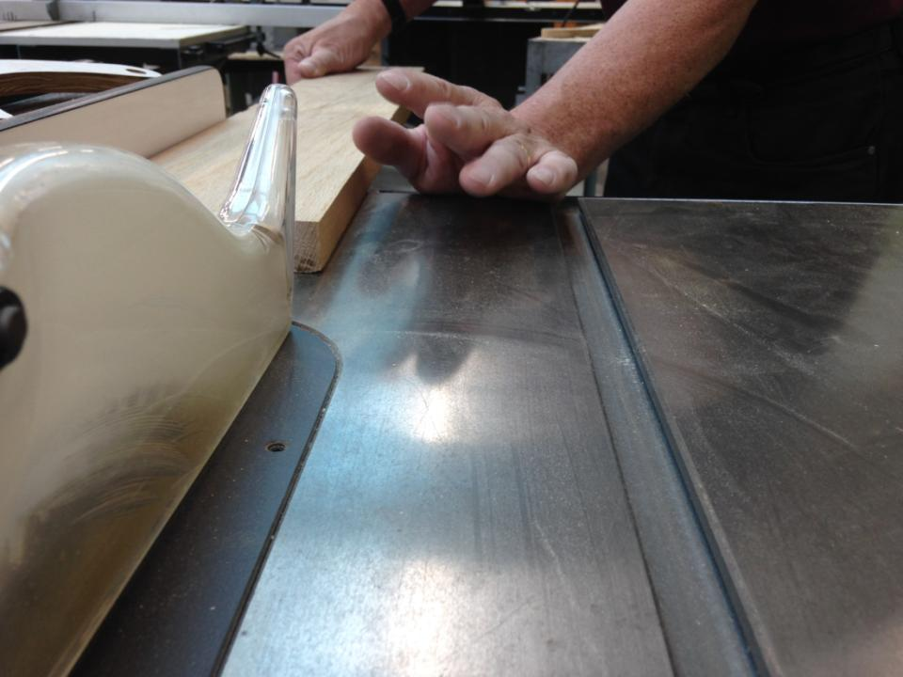

Slide 16
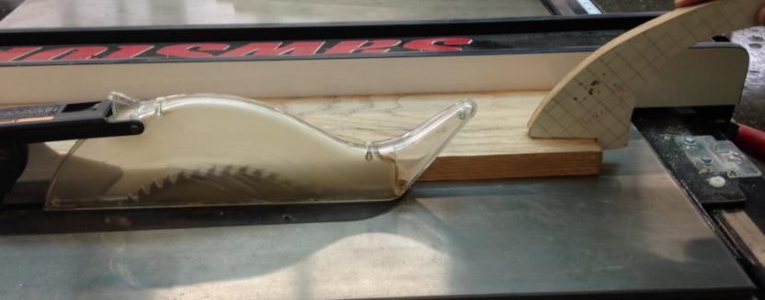
Place the push stick nearer to the blade than to the fence. Angle it toward the fence.

Slide 17
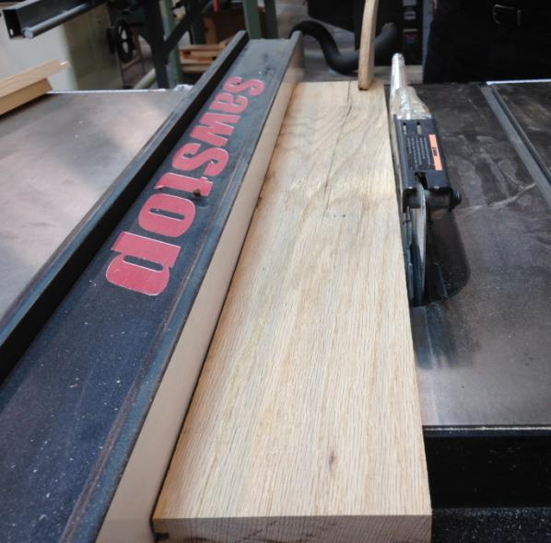

Slide 18
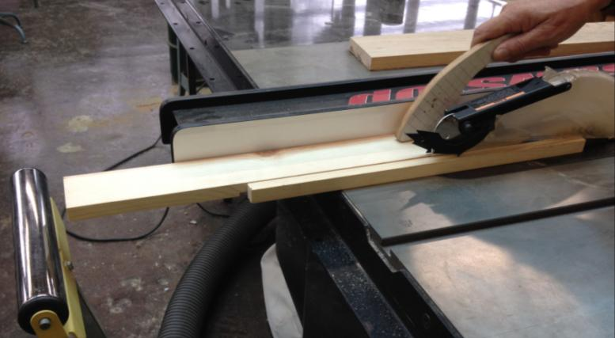
Push the board all the way past the blade.

Slide 19
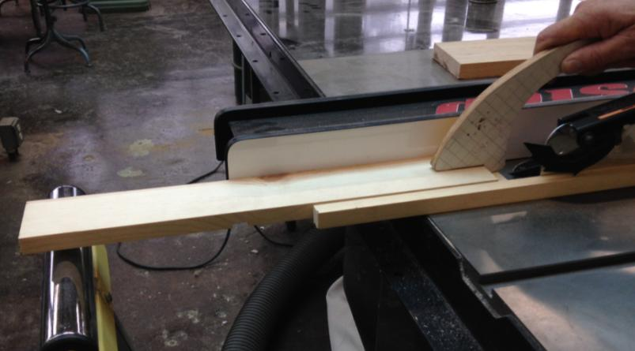
Like this… And your left hand never goes past the blade.

Slide 20
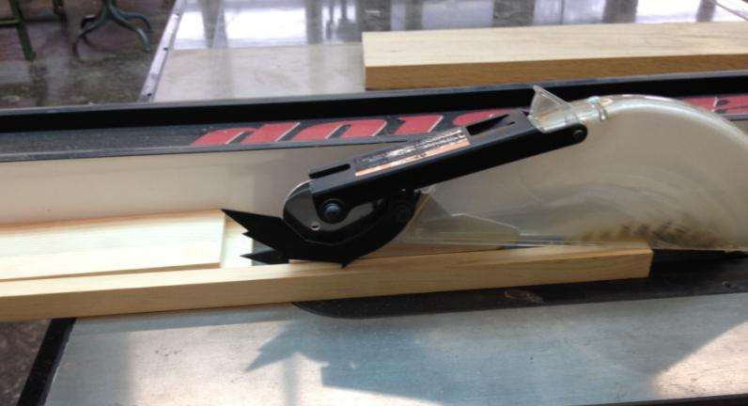
Leave the piece on the left side of the blade where it is until the blade stops.

Slide 21
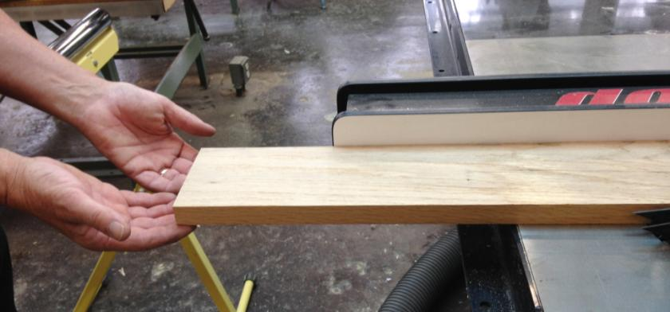
“Tailing off”—you don’t own thumbs. Just support; don’t pull.

Slide 22
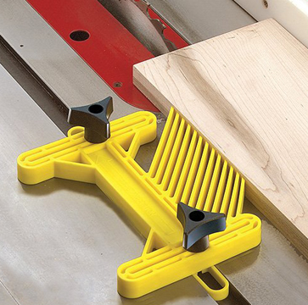
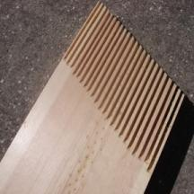
Feather Boards
Feather boards are designed to maintaining accuracy by securely pressing the work piece against the fence or table.
They also help avoid kickbacks while keeping fingers clear of the blade
To avoid kickback, it should always be mounted behind the blade.
Shop made
Store bought

Slide 23
Safety Rules
1. Wear safety glasses. Pull back loose hair, sleeves or jewelry.
2. Make adjustments only with the machine stopped.
3. Set the blade height no more than 1/8" above your wood (≈ height of one tooth on blade).
4. Have a clean, straight edge (from the Jointer) to put
against the fence. Use the board’s longest side to guide it (Rule of Rectangle.) Lock the fence.
5. Wood must lie flat on the table saw.
6. Don't cut through loose knots or nails. On SawStop saws NO METAL and NOTHING WET.
7. Use the guard. If cut is not possible with guard in place, see teacher for a safe way to make your cut.

Slide 24
8. Keep your left hand “planted” on the front edge of the table saw. Do not advance your left hand toward or over the blade.
9. Check that no one is standing behind you where they might be hit in case of kickback.
10. When “tailing off”, only support the board. Do not pull the board.
11. Use a push stick for any cuts narrower than 5”.
12. Keep the stick closer to the blade than the fence and angle it toward the fence.
13. Don't use the fence and miter gauge at the same
time.
14. Never saw freehand which means cutting without
the fence or miter gauge.

Slide 25
15. Never back up on a cut. Turn off the saw if board becomes stuck.
16. Feed the material at a reasonable rate of speed.
Don't overload machine by going too fast or burn
the wood by going too slow.
20. Don't reach over a moving blade.
21. Never reach for the left over scrap! Allow the blade to come to a complete stop before removing off-cuts.
Use jigs for small work whenever possible.
When you are finished lower the blade.
24. Clean up your area.

Slide 26
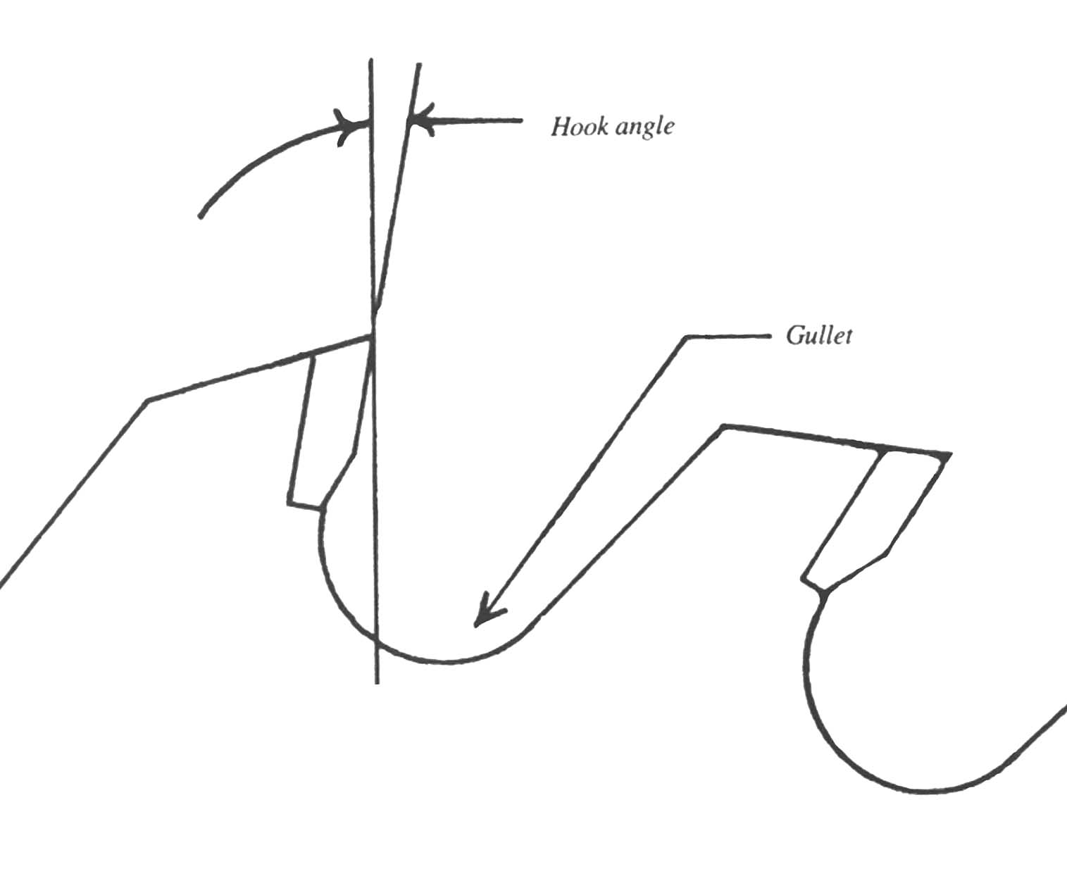
Saw Blades & Teeth
A circular saw blade is like a gear. The teeth are wedge shaped cutting levers around a wheel & axle.
More about saw blades
More about Table saws
Direction of feed.
Gullets separate each tooth with a space for sawdust.

Slide 27
Saw Teeth come in a variety of shapes.
1/8”
Rip teeth
Flat top
The kerf is the 1/8” space left by the blade during a cut.
Crosscut teeth
Alternating top bevel
Hollow Ground
Triple Chip

Slide 28
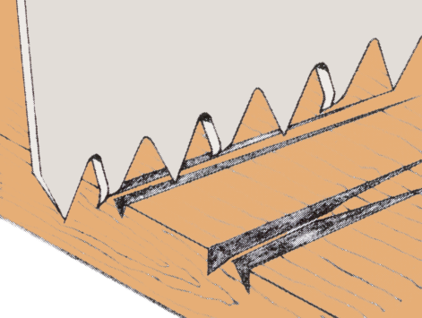
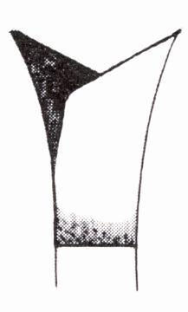
Crosscut teeth have a knife shape that scores across the wood fibers cutting them out without tearing or blowing out at the edge.
Set
Sewing needle
Set (bent) alternately side to side, a needle can ride down the V-groove left between the teeth of a well sharpened old fashioned steel crosscut saw blade.
Grain direction

Slide 29
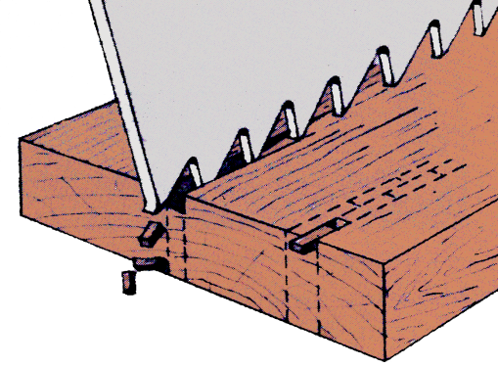
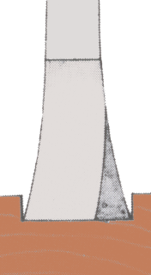
Rip teeth have a chisel shape that cuts the wood fibers and mostly rips them out in chunks with the grain.
If used across the grain, rip teeth will blow out the wood fibers.
Grain direction

Slide 30
It doesn’t matter which side of the blade the arbor nut is… to keep the blade from coming loose during use on any circular saw, the arbor nut that holds the blade secure always loosens in the same directions as the blade turns.
Loosen

Slide 31
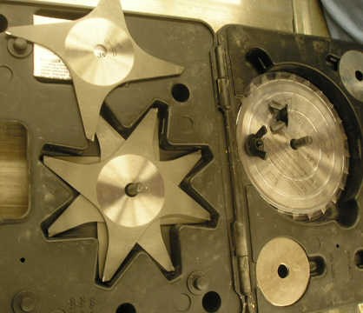
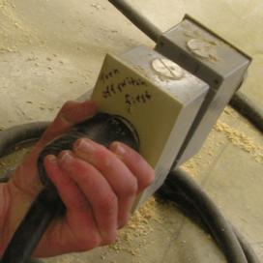
The regular dado blade requires assembling a series of blades and chippers.
Clearly marked by size.
The dado set comes with two outer blades, and six inner chippers.
Unplug the machine before beginning.
Outer blade
Chippers
Spacers

Slide 32
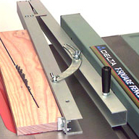
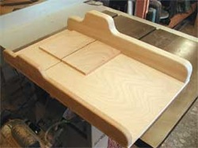
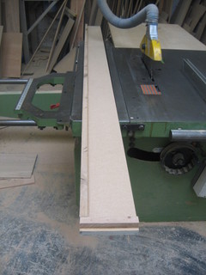
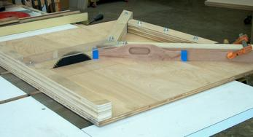
Sleds and Jigs
Taper jig
Craftsman often have to make their own jigs and sleds.
Crosscut sled
There is not enough room to represent every conceivable sled and jig.
Miter sled
Straight-line jig

Slide 33
Rabbets and dados can be made using a stack of blades.

Slide 34
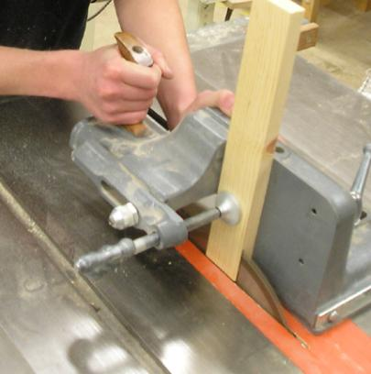
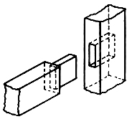
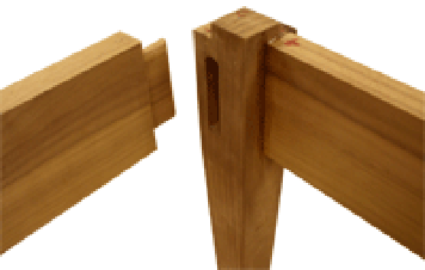
The mortise and tenon joint is a popular furniture construction technique.
Mortise & Tenon Jig
Leg and rail.
Cutting an open mortise with the table saw. The joint is self supporting with more surface area that holds more glue making the joint very strong.

