Slide 1
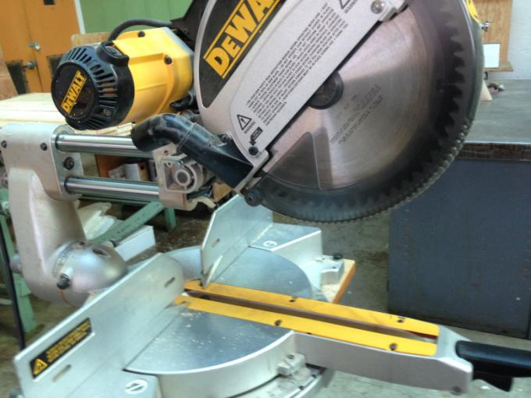
Sliding Compound Miter Saw

Slide 2
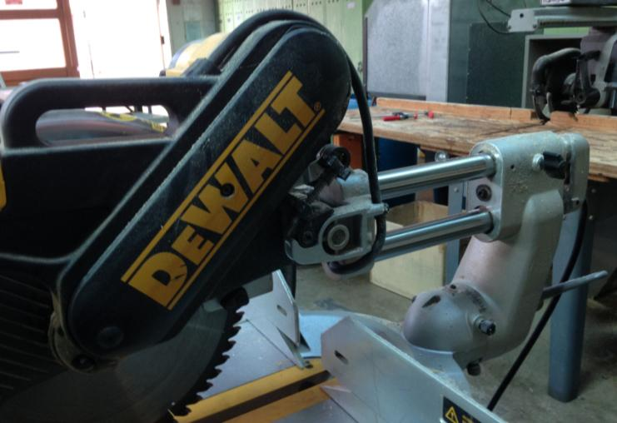
Saw locked in down position.

Slide 3
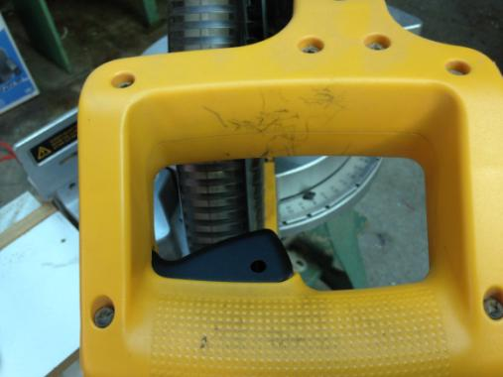
To release the saw, you must do two things: 1.) Push down slightly on this yellow handle and…

Slide 4
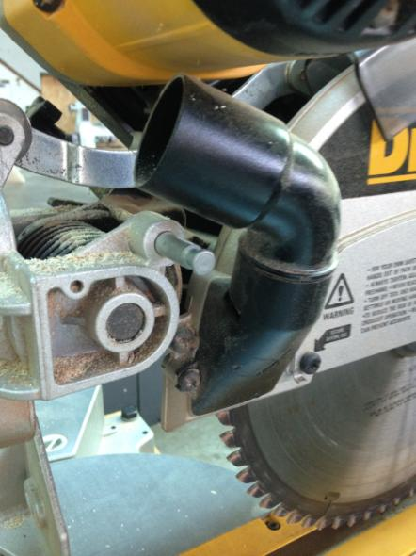
While gently pushing down on handle… 2.) pull out this pin. Then let the saw up.

Slide 5
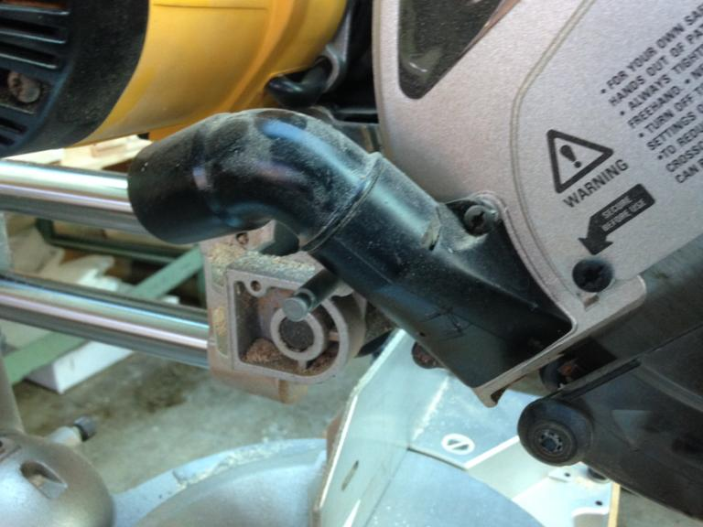

Slide 7
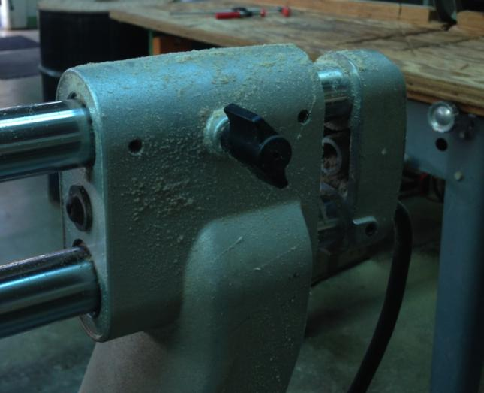
To allow saw to slide, loosen this knob.

Slide 8
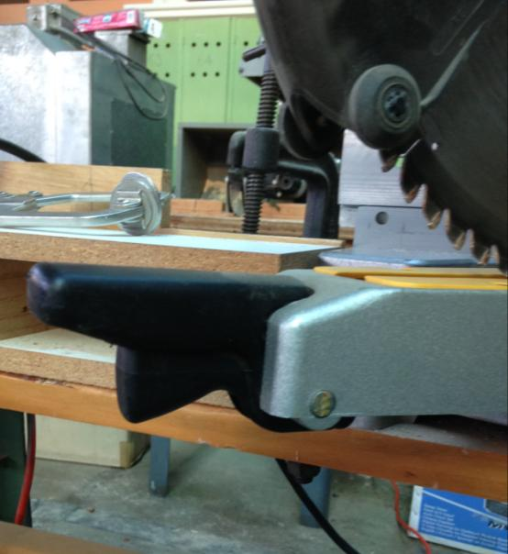
This handle and lever below it allow you to swivel the saw to cut at different angles.

Slide 9
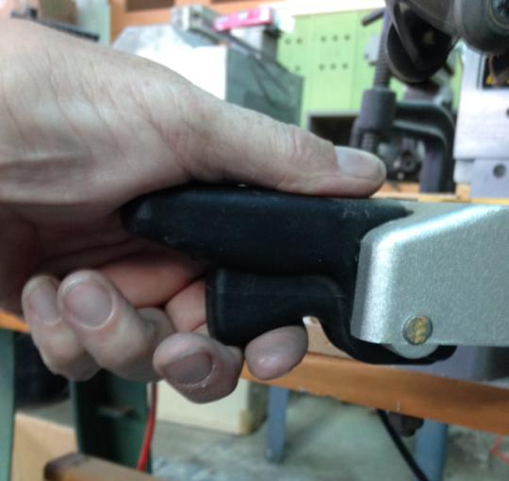
Squeeze the lower lever and swivel.

Slide 10
Cutting with this saw.

Slide 11
Safety

Slide 12
Wear goggles, of course.

Slide 13
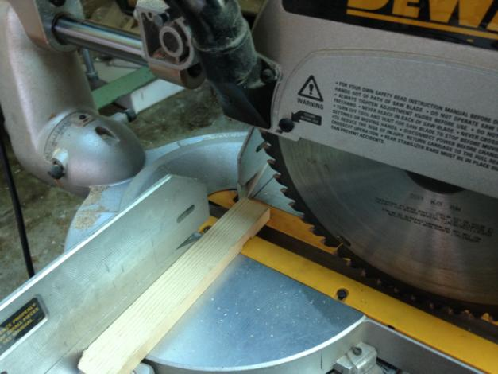
Hold wood tightly against the fence (rail).

Slide 14
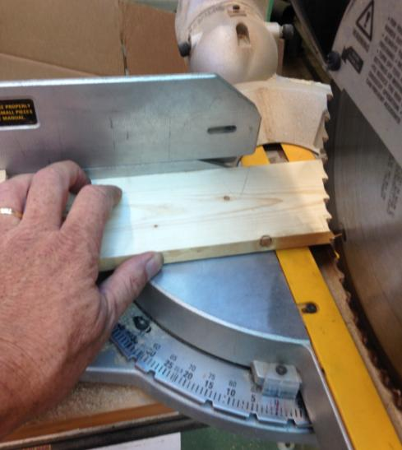
Pushing wood against fence. Keep fingers at least 6” from blade.

Slide 15
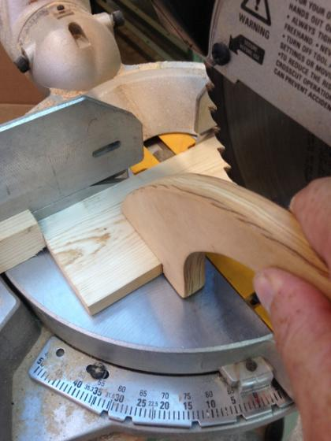
Keep fingers 6” from the blade. Use a clamp or push stick to hold small pieces.

Slide 16
Cuts are made in this direction.

Slide 17
On/off switch (trigger).

Slide 18
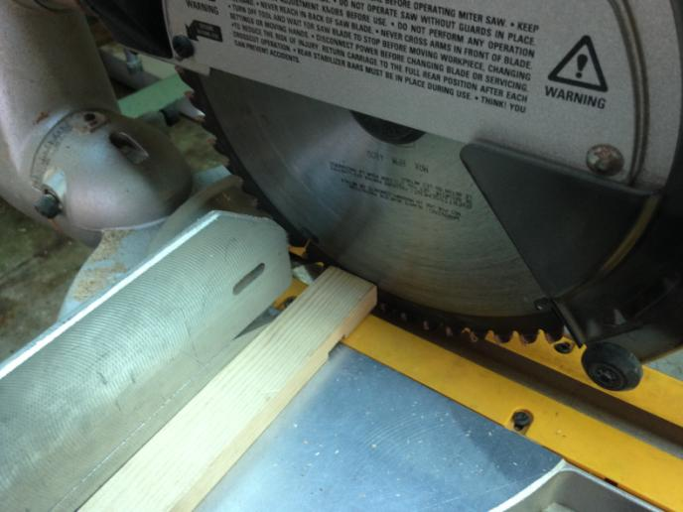
Finish the cut, release the trigger.

Slide 19
For a cleaner cut don’t raise the saw until the blade is completely stopped.

Slide 20
Use a stop block to cut multiple pieces to the exact same length.

Slide 21
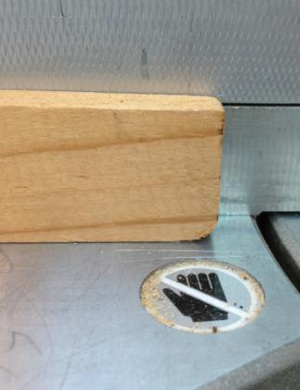
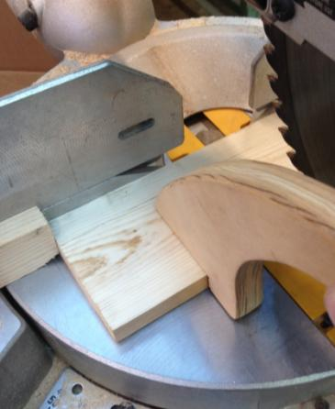
Cutting a notch in the stop-block gives sawdust a place to go.

Slide 22
