Slide 1
Delta Scroll Saw

Slide 2
Changing Blades

Slide 3
FIRST RELEASE THE TENSION BY MOVING THE TENSIONING LEVER FORWARD

Slide 4
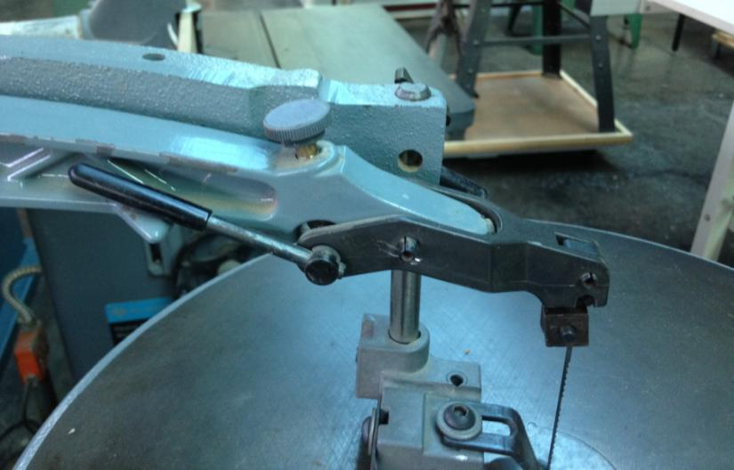
Release Tension—move lever forward.

Slide 5
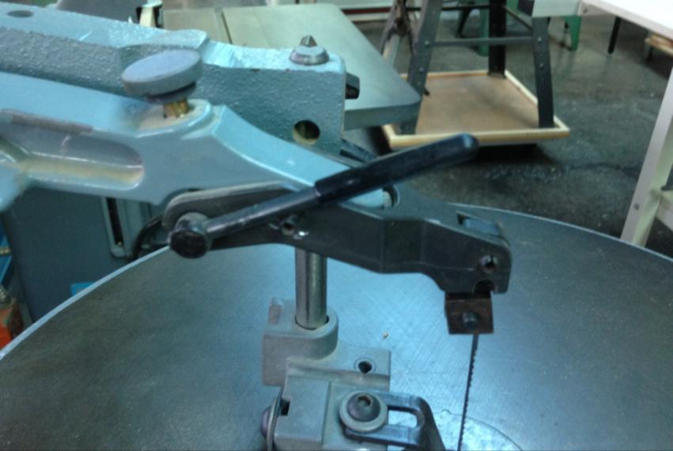

Slide 6
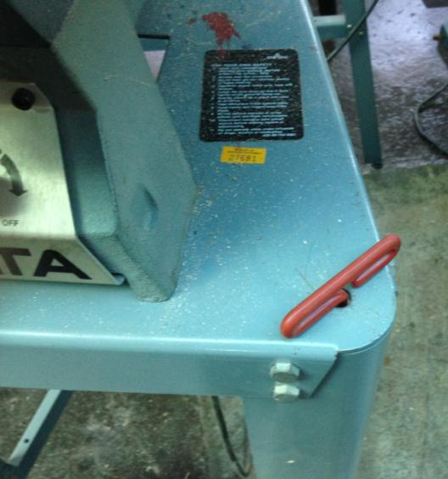
Handle of Hex Wrench to Loosen Blade Locking Screw

Slide 7
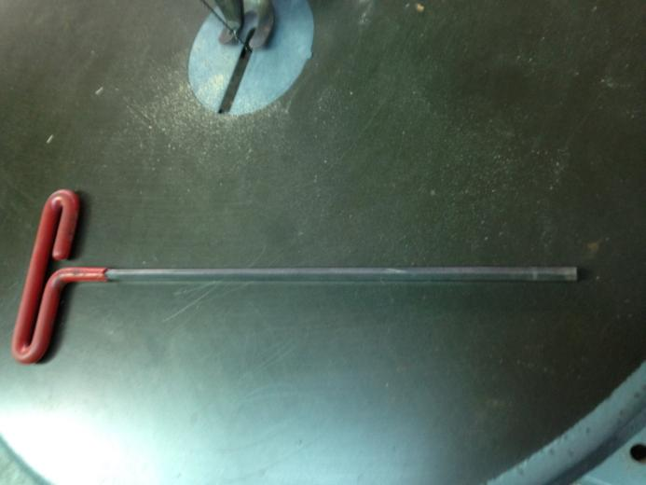
Hex Wrench

Slide 8
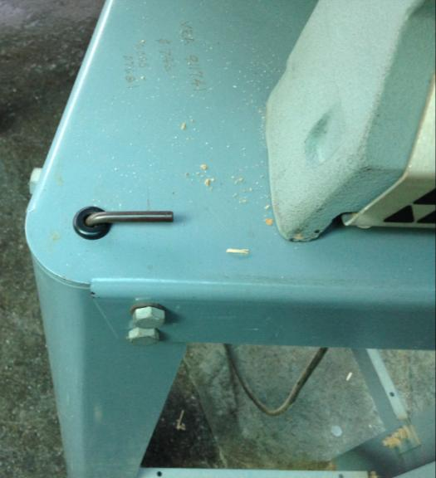
Tool to keep blade clamp from twisting while loosening screw

Slide 9
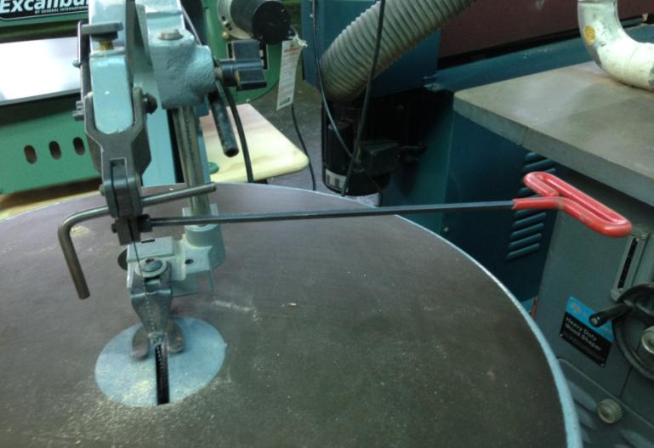
Use both tools to loosen clamp.

Slide 10
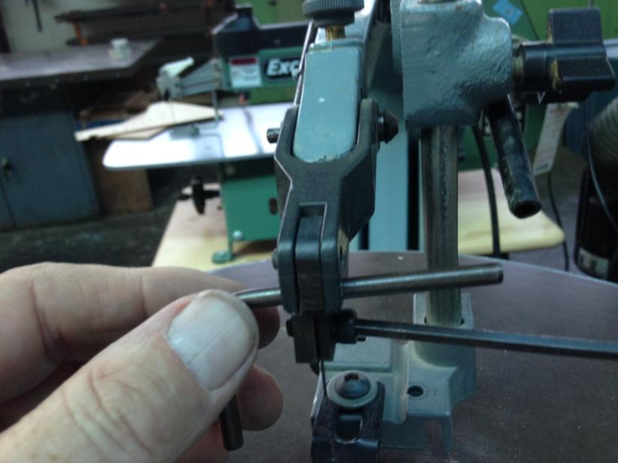

Slide 11
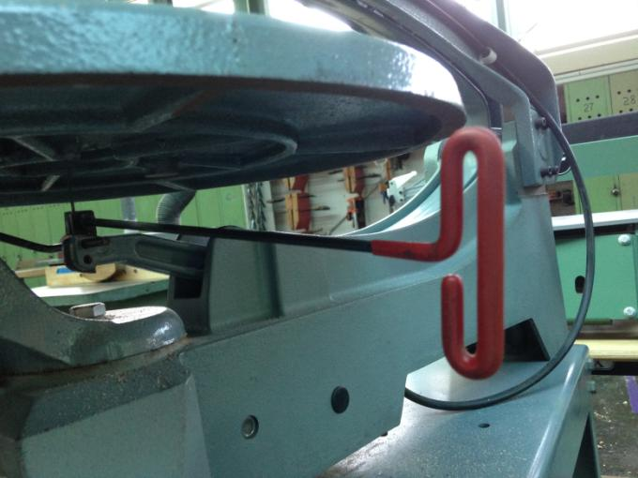
Loosen the bottom clamp with both tools the same as at the top.

Slide 12
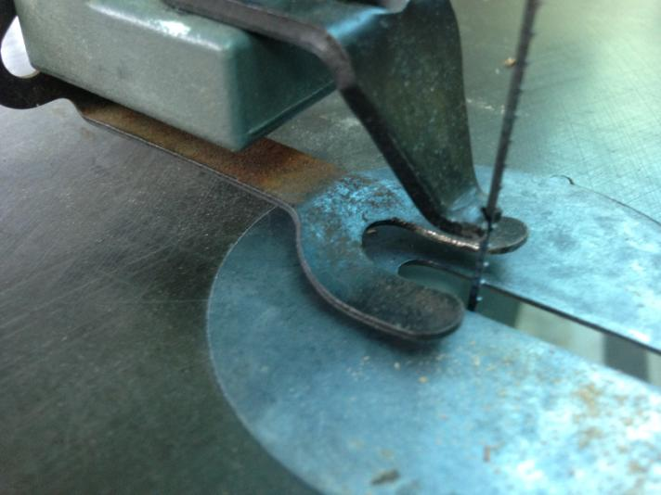
Removing this circular plate makes it easier to position the blade in the clamps.

Slide 13
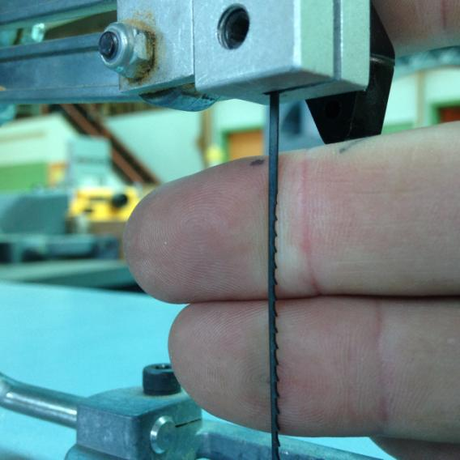
Don’t forget, the teeth point down.

Slide 14
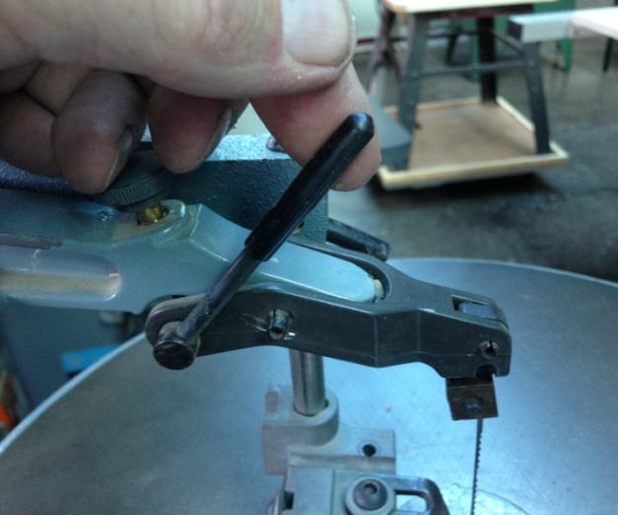
After installing the new blade, apply tension by moving the lever back to its original position.

Slide 15
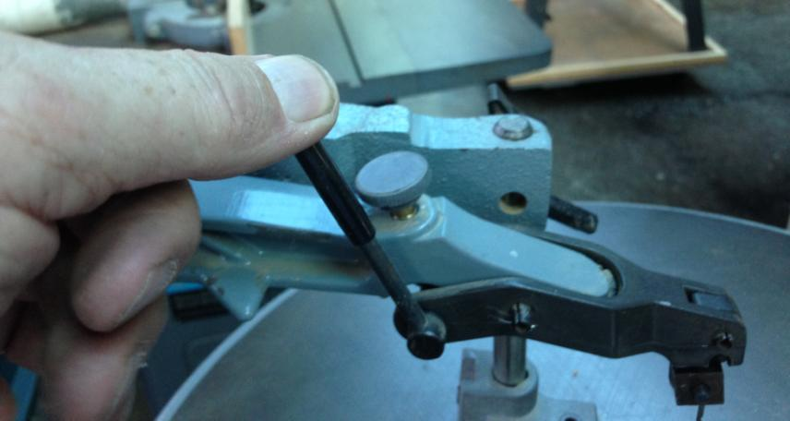

Slide 16
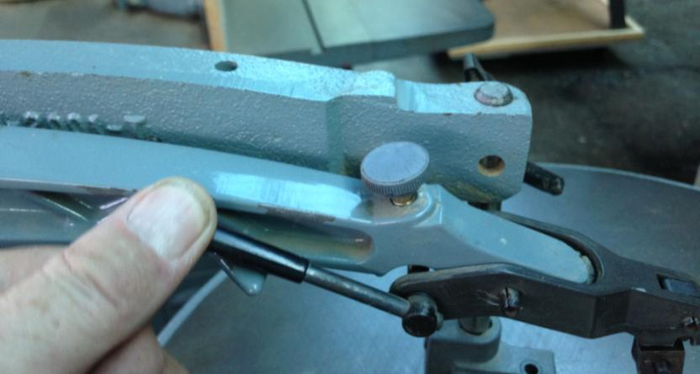
If the blade is too loose or too tight, release the lever, turn this knob, and tighten the lever again.

Slide 17
When plucked, the blade should ring with a high clear note.

Slide 18
Guide (V-shape) goes directly behind, but not rubbing on blade.

Slide 19
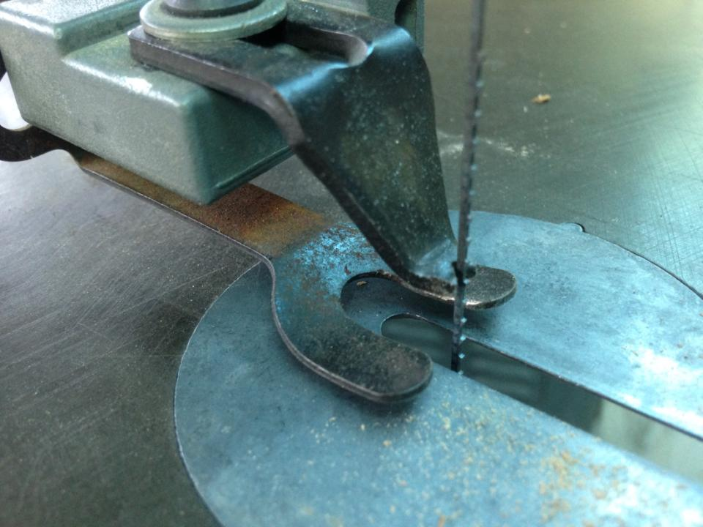

Slide 20
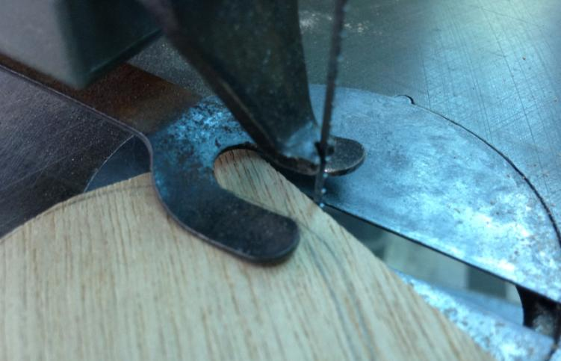
Pressure foot sits directly on wood to keep wood from bouncing up and down with the blade.

Slide 21
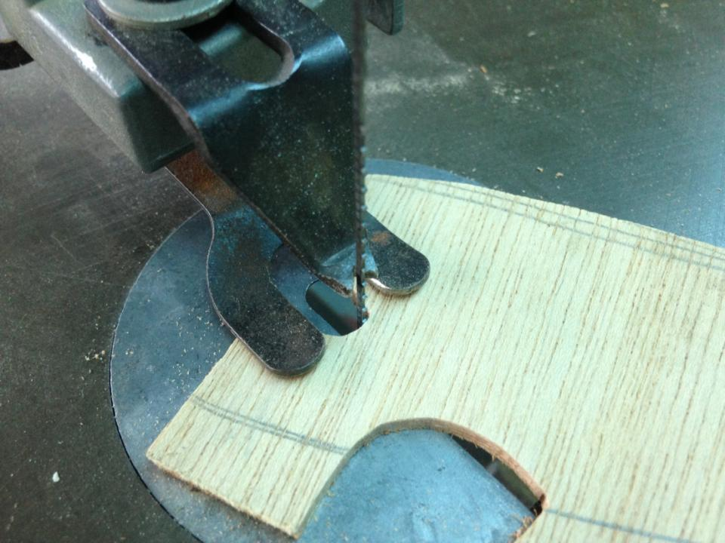

Slide 22
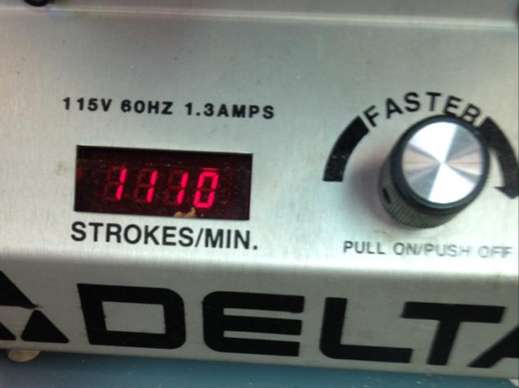
On/Off and Variable Speed Control

Slide 23
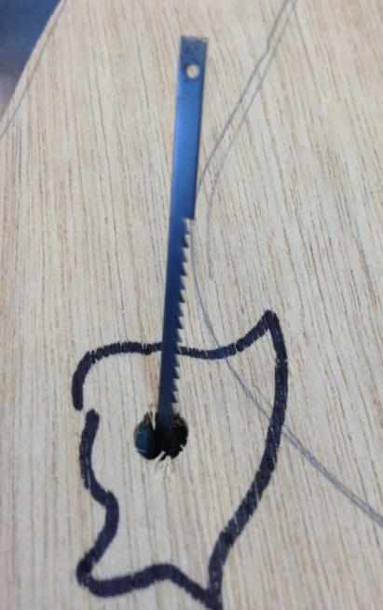
MAKING INSIDE CUTS—Drill a hole insert the blade through the hole.

Slide 24
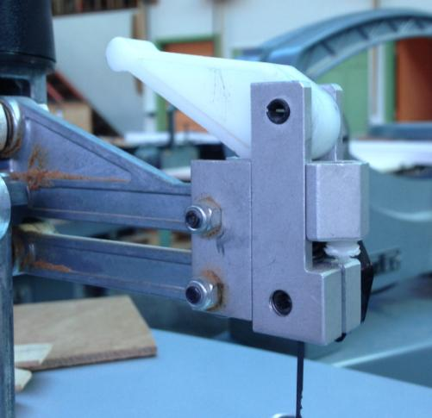
Excalibur Scroll Saw Tensioning Lever

Slide 25
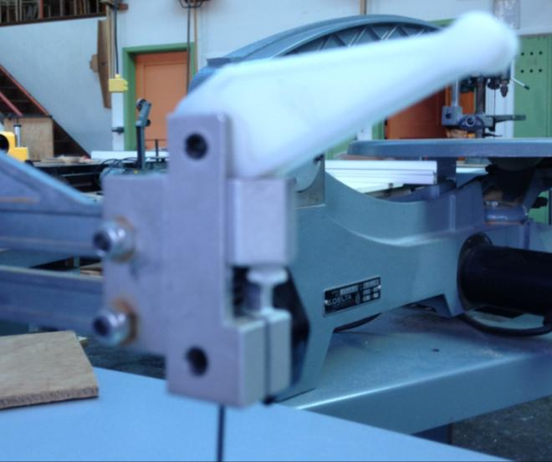

Slide 26
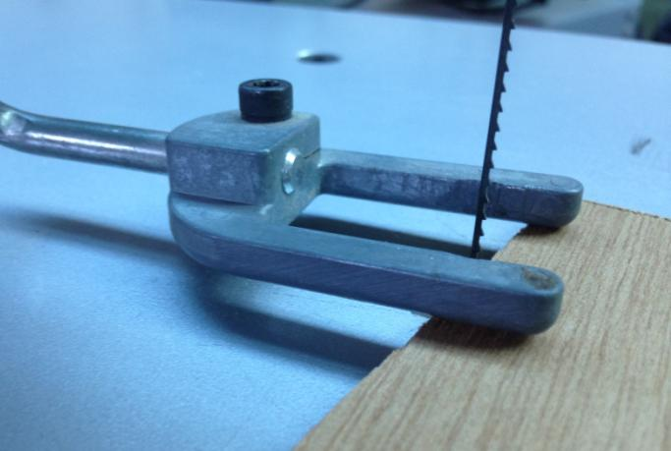
Pressure foot on Excalibur Scroll Saw.

Slide 27
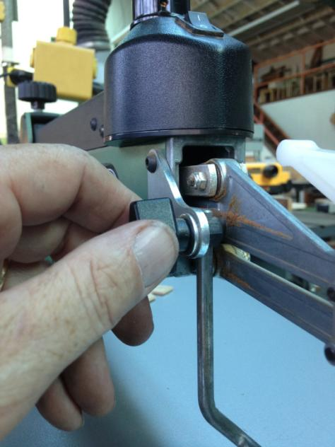
Adjusting the height of the pressure foot.

Slide 28
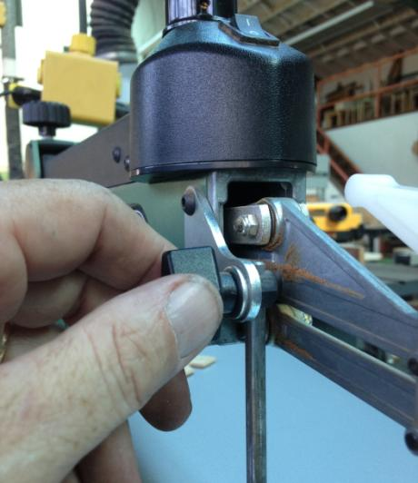
Knob to make small adjustments to tension.

Slide 29
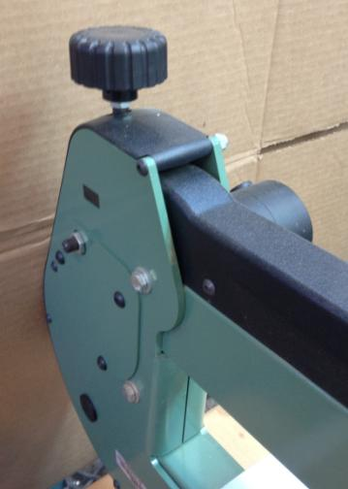
Adjust tension here.

Slide 30
On/Off Switch

Slide 31
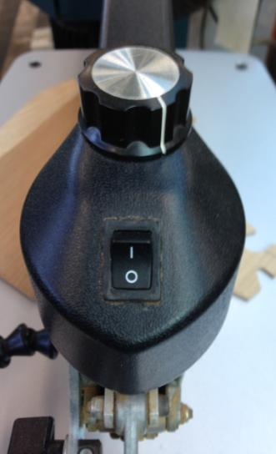
Set speed On/Off Switch

Slide 32
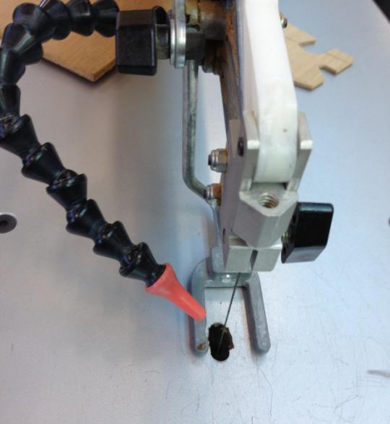
Plastic tube blows sawdust away so you can see where you are cutting.

