Slide 1
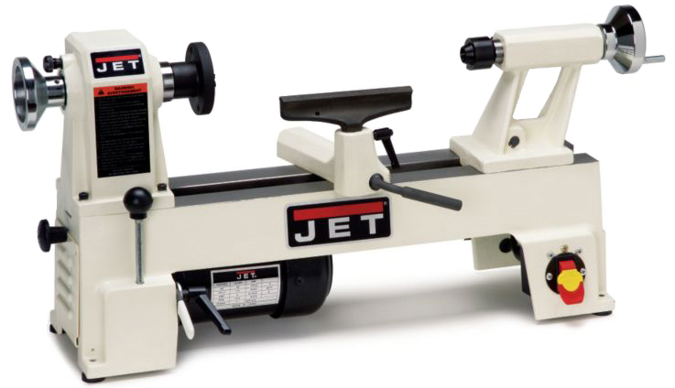
Woodturning
The wood lathe produces round project parts.

Slide 2
SPINDLE TURNING = “TURNING BETWEEN CENTERS” = SPUR DRIVE IN HEADSTOCK AND CENTER IN TAILSTOCK

Slide 3
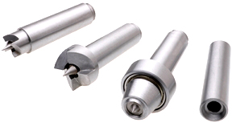
Small Spur Center
Large Spur Center
Live Center
Dead Center
Spindles are held between a spur center and live or dead center.
Live Center

Slide 4
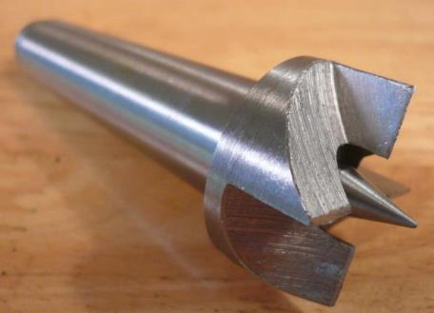
Cut two kerfs in the wood crossing in the center to fit on the spur drive.
Spur Drive

Slide 5
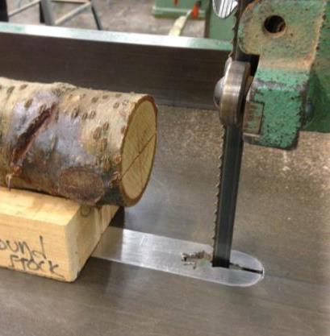
Cut the kerfs with a handsaw OR a V-Block and the bandsaw.

Slide 6
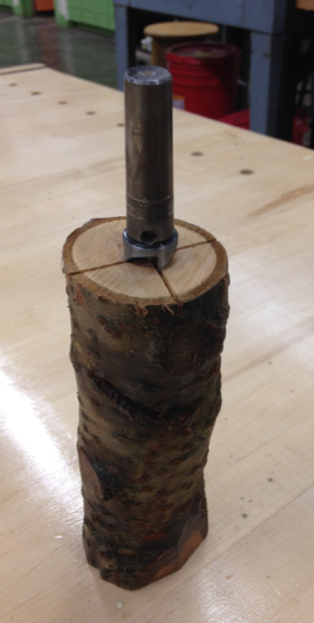
Place the wood on a solid table or floor. NEVER pound on the wood in or on the lathe.

Slide 7
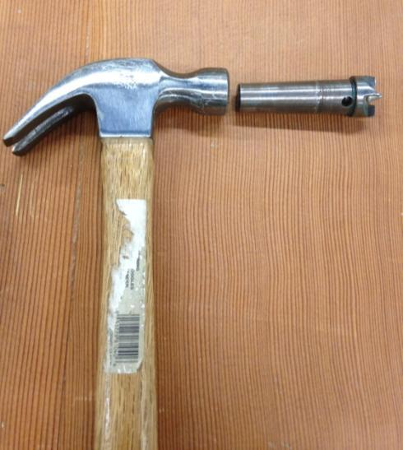
Never use a hard metal hammer. It will “marshmallow” the end of the spur drive.

Slide 8
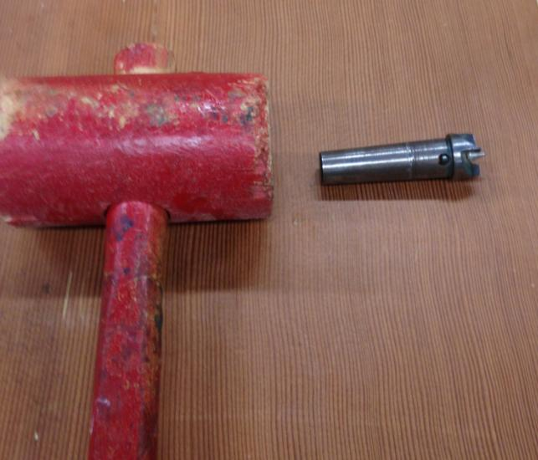
Use a wooden mallet.

Slide 9
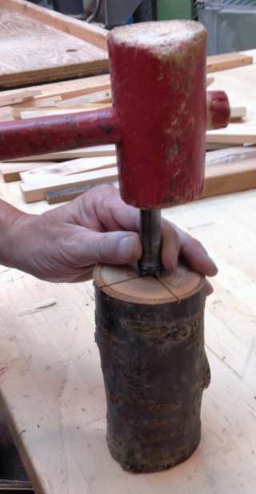

Slide 10
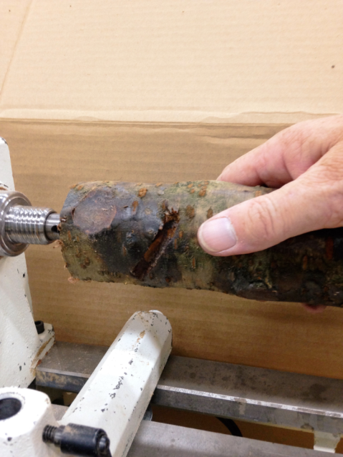
Place the spur drive with the wood in the headstock.

Slide 11
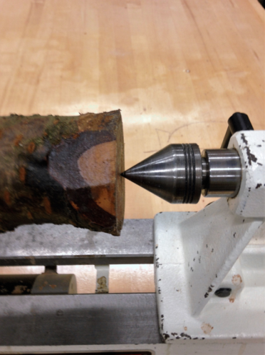
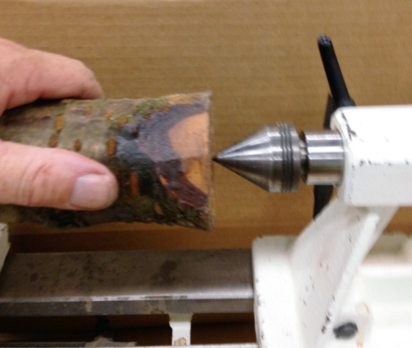
Hold the other end with a center in the tailstock.

Slide 12
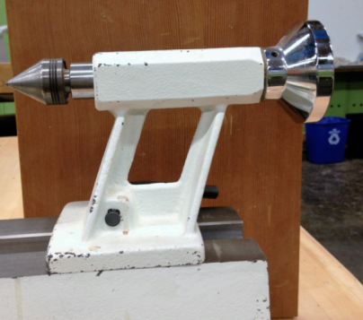
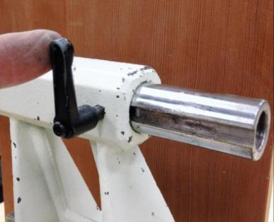
Check that the groove lines up with the bolt.
Front Side
Back Side

Slide 13
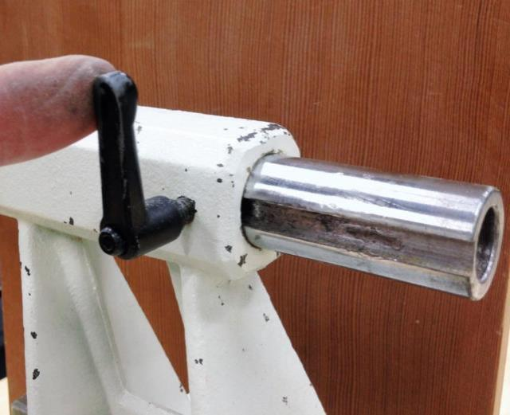

Slide 14
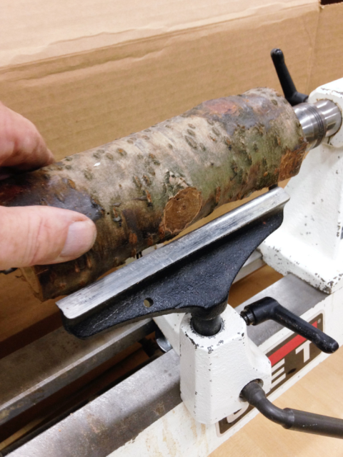
1. Check for end-to-end play. 2. Rotate the wood by hand to make sure it doesn’t hit the tool rest.

Slide 15
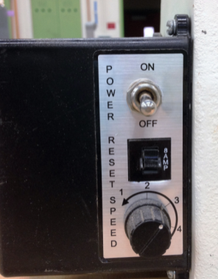
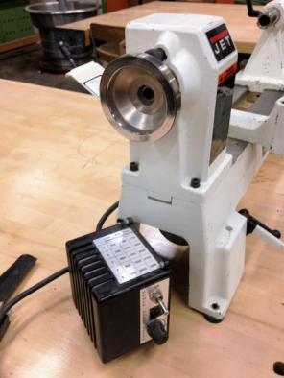
Start on SLOW SPEED. Speed is controlled with a dial and with pulleys and belts.

Slide 16
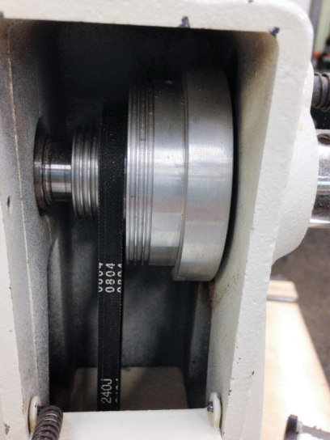
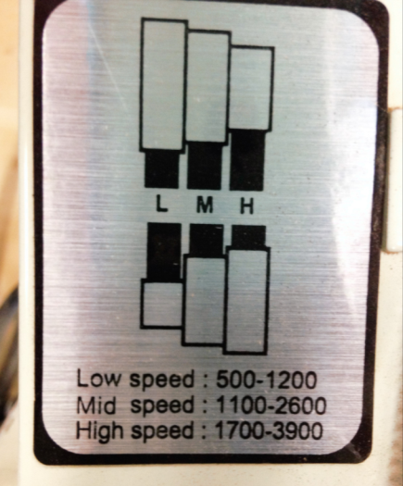

Slide 17
ABC’s of Lathe Turning

Slide 18
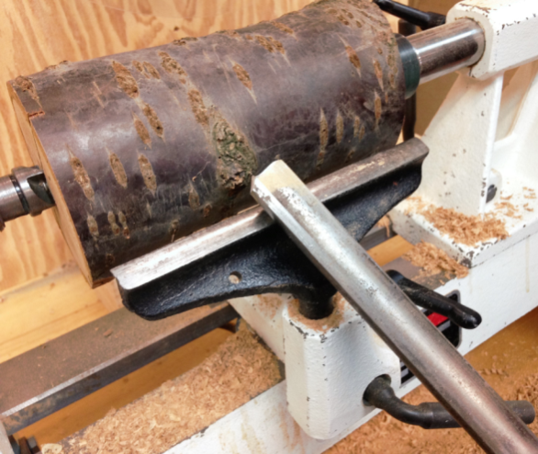
A = Anchor the Tool on the Tool Rest.

Slide 19
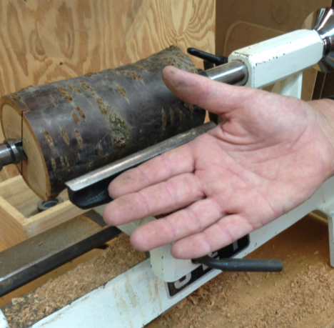
A = Anchor Your Hand on the Tool Rest too. Like this…

Slide 20
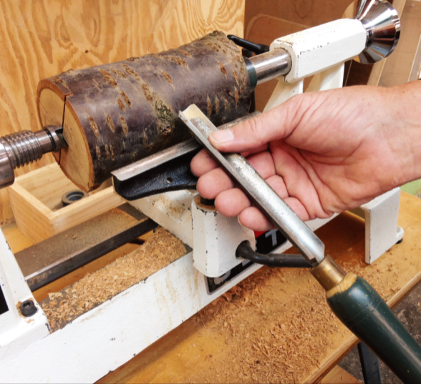
Like this…

Slide 21
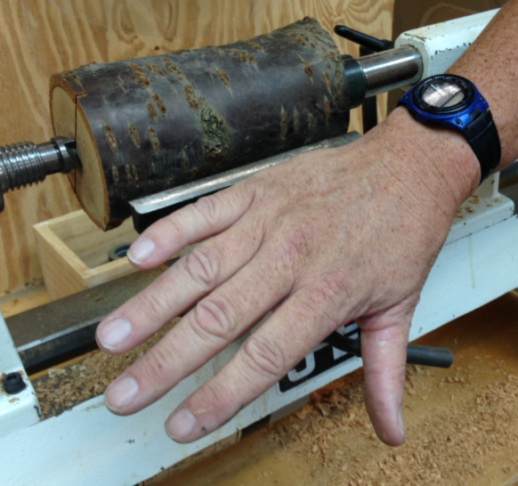
or like this.

Slide 22
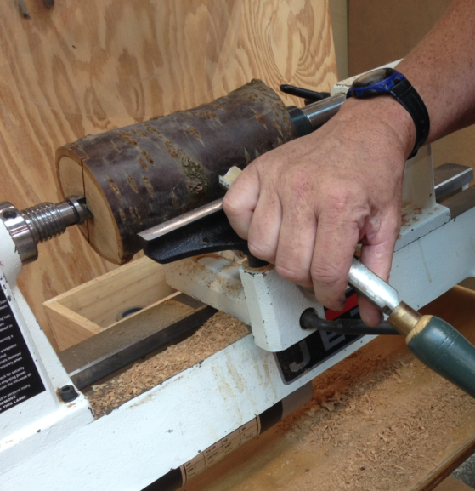
Like this.

Slide 23
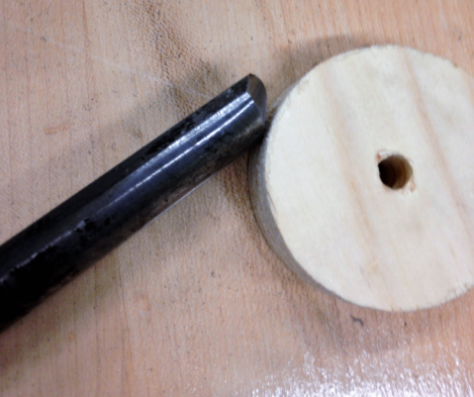
B = Bevel.

Slide 24
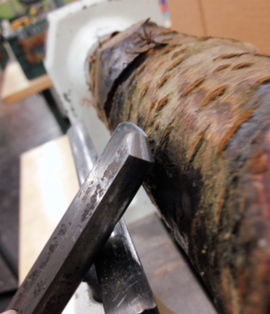
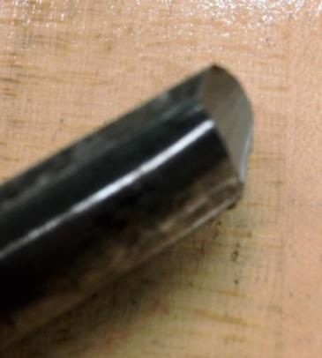
B = Bevel. Touch the wood with the BEVEL first.

Slide 25
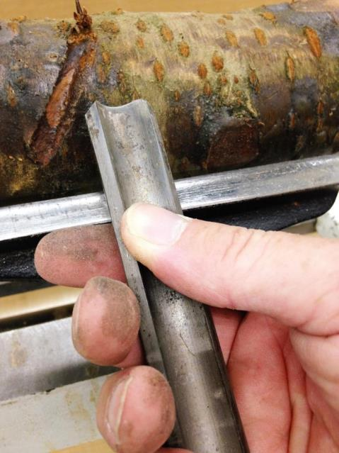
This tool is a roughing gouge. You always tilt it upward.

Slide 26
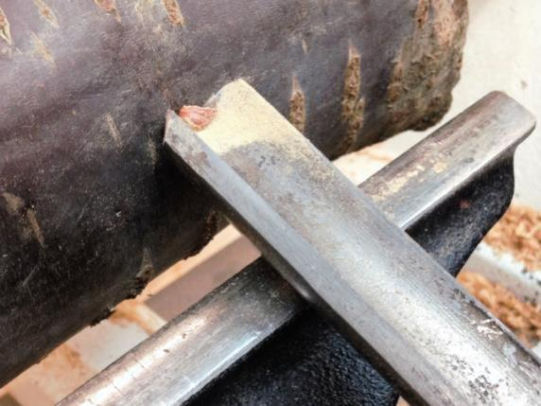
C = Cut. Gradually raise the handle and lower the cutting edge into the wood until it begins to cut.

Slide 27
To get the proper leverage, keep the tool rest close to the work.
With the tool rest close, the tool is easier to control.
The steep angle of the tool is a shear cut which is more efficient.

Slide 28
If the tool rest is too far from the work, the tool is hard to control.
A scraping cut is less efficient and puts more stress on the work.

Slide 29
Not to mention the fact that leverage that favors the machine over the operator can rip a tool from your grasp.

Slide 30
Think Safety
Wear a face shield.
Make sure everything is properly tightened.
Anchor the tool & your hand on the tool rest.
Use mostly lower speeds.
Keep the tool rest 1/8” from the project.
Keep the tools sharp.
Remove the tool rest before sanding.

Slide 31
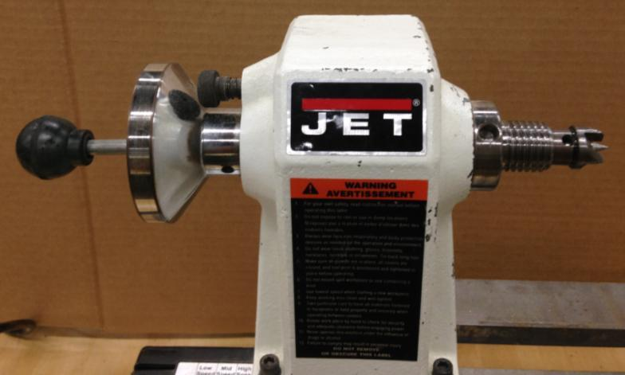
Use the knockout bar to tap on and loosen the spur drive

Slide 32
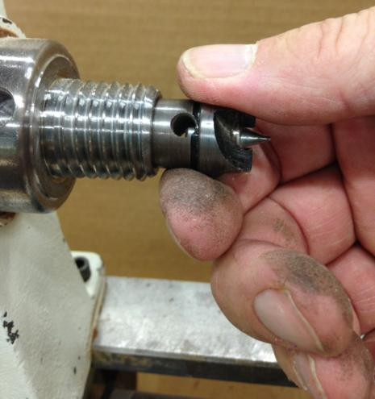
Keep your hand on the spur drive to catch it so it doesn’t fly out and land on the hard floor.

Slide 33
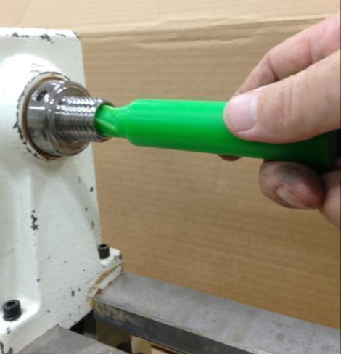
Clean out any sawdust or grit from inside the head stock with the green squeegy.

Slide 34
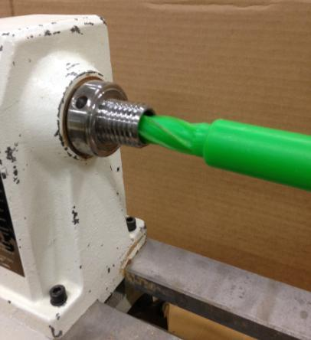
Grit will cause pits, grooves and burrs preventing the spur drive from seating properly and also make it difficult to remove the spur drive.

