Slide 1
Thanks to Tom Bockman, of Prescott, Arizona who created this slideshow.

Slide 2
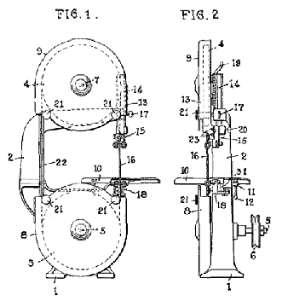
The Band Saw
Powered saws are more efficient requiring less skill to operate. This makes band saws ideal for fast and cheap manufacturing.
A sketch from a 1933 patent document shows that the bandsaw is a steel band with saw teeth around two pulley wheels with one main function…. to cut circular patterns.

Slide 3
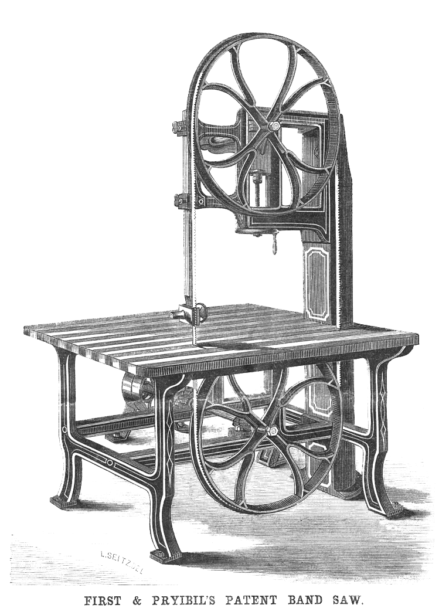
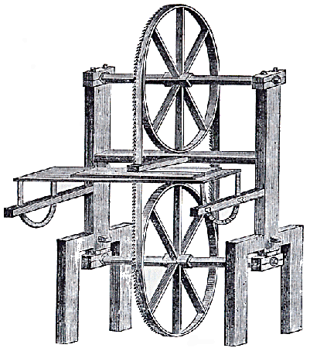
The power bandsaw actually started out more than 100 yrs. before that patent.
1840’s
Everything used to be tediously cut with hand tools.
Exposed blade
This 1808 sketch shows a definite band sawing machine.
It is obvious that safety was not a major consideration in any of the early machines. This was a catastrophe waiting to happen.

Slide 4
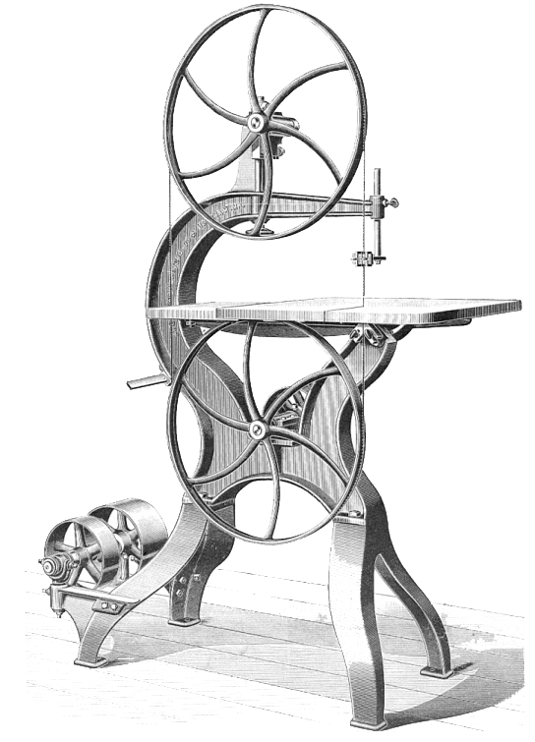
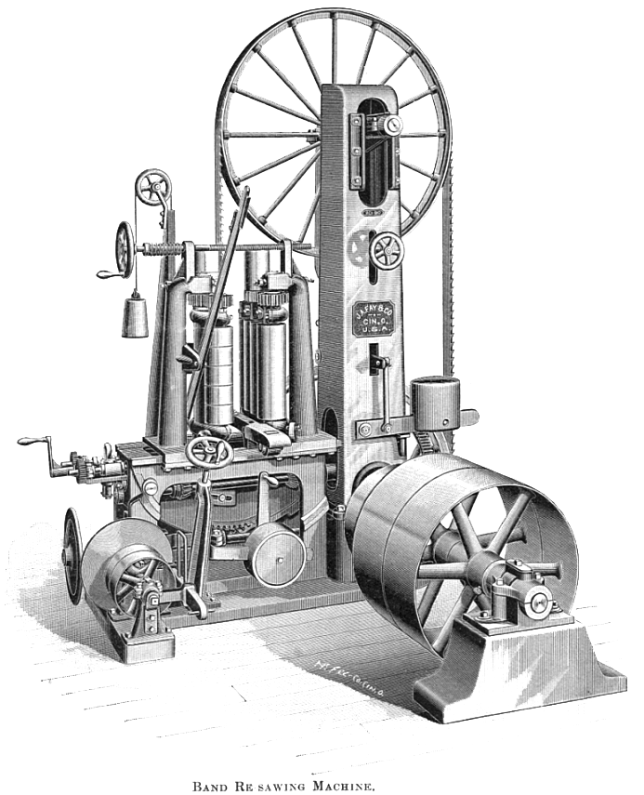
1850’s steam powered

Slide 5
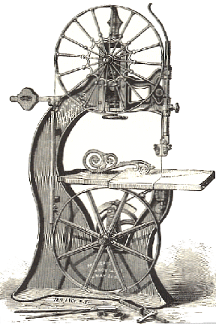
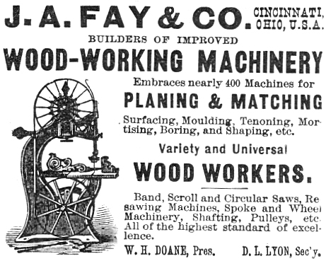
By 1878 the only noticeable additions were in the Victorian styling of the machine. What makes it look more beautiful seemed to take precedent… but there does seem to be a limited blade guard on the return (left) side.
This gorgeous machine still lacks many of the safety features we take for granted today.

Slide 6
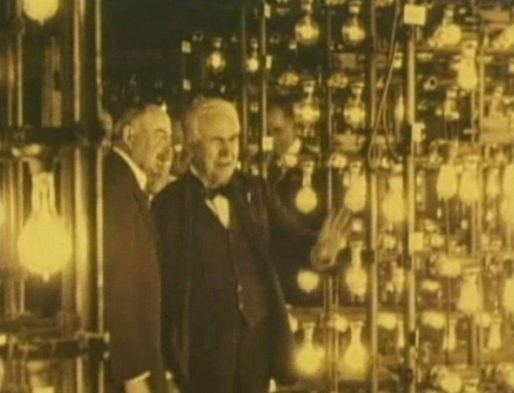
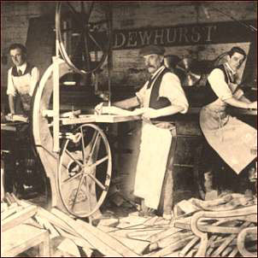
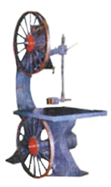
By 1900, little had changed except maybe electricity and the removal of the Victorian gingerbread.
Thanks in large part to Edison Electric Company, electricity was in full scale use.
Thomas Edison
Forget the guarding situation for a moment… let’s talk about keeping work spaces clean. How about this turn of the century shop?

Slide 7
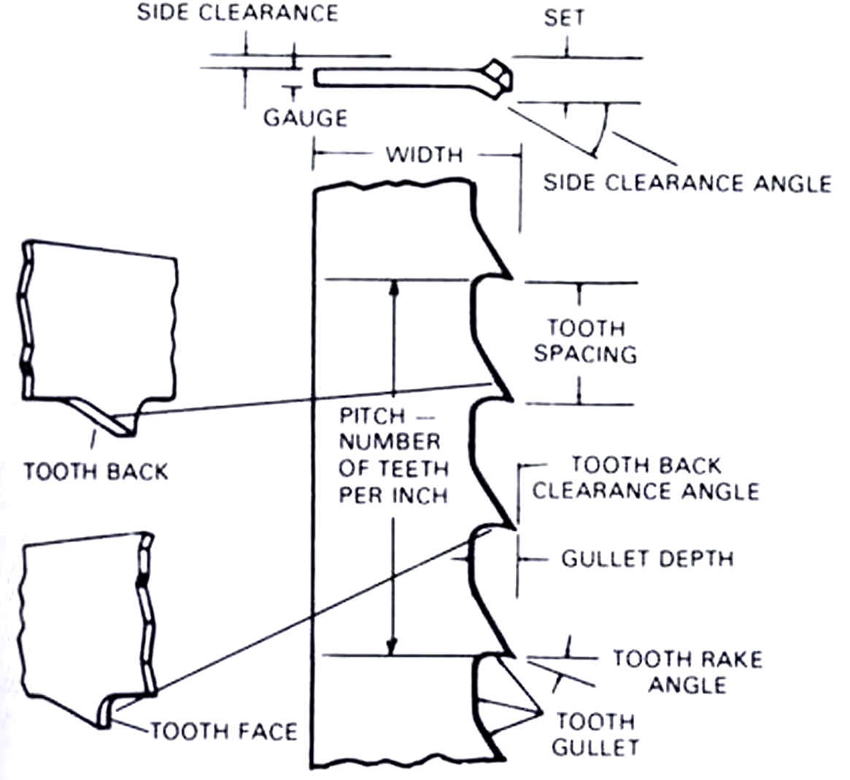
Let’s talk teeth…
Crosscut teeth are set (bent alternately side to side) and band saws leave a thinner kerf (space) then other saw teeth.

Slide 8
Don’t these bandsaw blades look harmless?
Band saw teeth are designed to cut efficiently!
Forget the fact that butchers use these to cut up meat…

Slide 9
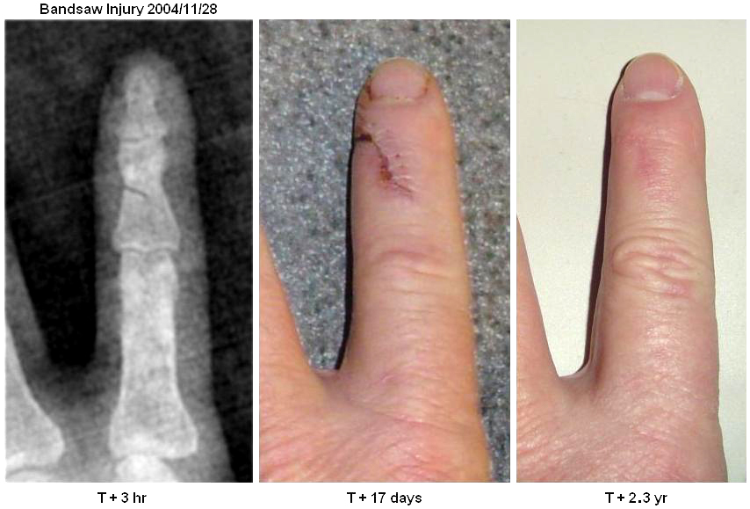
This guy was kind enough to post his bandsaw injury on the Internet so others could learn from his mistake.
The perfect case for the 4” safety margin and also for using guards. Look closely and you can see where in a split second, he nearly cut through the bone.
There are almost 4000 reported (and usually avoidable) injuries each year.

Slide 10
Calculate the Length of a Bandsaw Blade.
π (3.14) x diameter of wheel equals the wheel circumference, added to twice the length between hub centers, equals the bandsaw length.
Find the wheel circumference
using π (3.14)
Diameter
2. 3.14 x d (diameter) = circumference
3. Measure the distance between hubs
Twice the length between hubs
4. Multiply that distance times 2
Blade
5. Add that to the circumference
6. The result is blade length
Formula
πd + 2(distance between hubs) = Length of blade

Slide 11
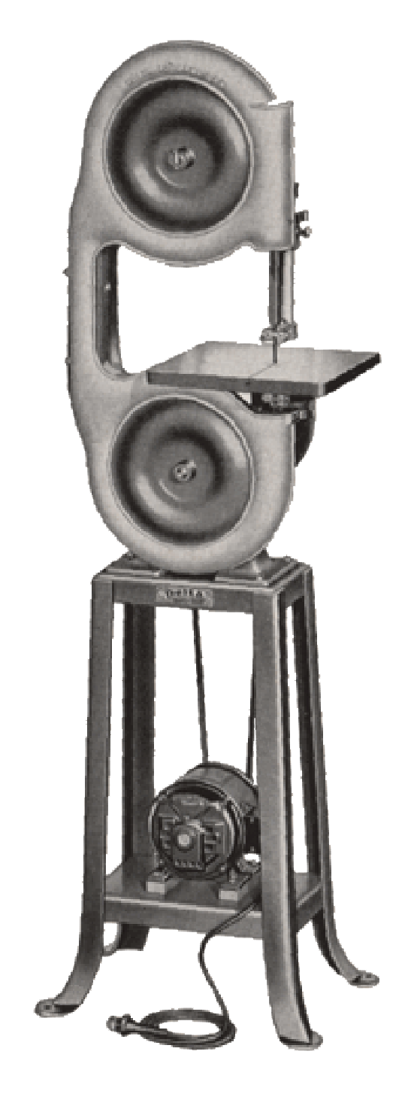
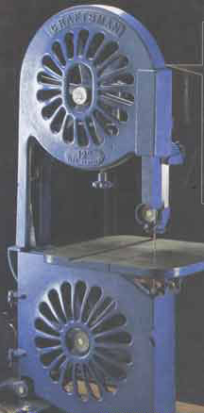
Now… back to that 1930’s patent… here’s the machine.
Looking a little more like today’s bandsaw, the designer Tautz knew that the future would demand safer equipment.
Sears state of the art model for the 1930’s.

Slide 12
Safety Rules.
1. Wear safety glasses.
2. Make all adjustments with the machine at a
dead stop.
3. The top guide should be as close to the
work as possible, at least 1/8".
4. Allow the machine to reach full speed
before beginning a cut.
5. Plan your cutting to avoid backing out of a
kerf.
6. Feed the material at a moderate rate.
7. Keep a 4” safety margin.

Slide 13
8. Make relief cuts to avoid pinching the blade.
9. Stock should be flat on one side. Use a
V- block when cutting round stock.
10. Have the teacher check special setups, angle
cuts & resawing operations.
11. If the blade hangs up or breaks, turn off the
machine and tell the teacher.
12. When finished, shut off machine and let it come
to a stop before cleaning.
13. Clean up the surrounding area.

Slide 14
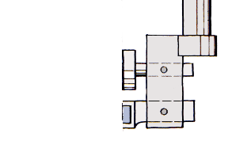
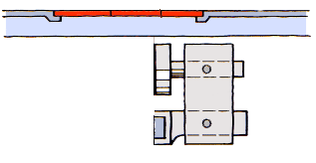
The Guide Assembly
Guidepost
Blade
Lower the guide post for less blade exposure.
Nomenclature
Thrust bearings
Guide bearings
Guard removed for clarity!

Slide 15
There is really no way to provide reverse thrust bearings at the front of the blade since it would interfere with the teeth.
Reverse
Possibly causing severe injury!
So backing out of a cut can pull the blade off the drive wheels.
THRUST DIRECTION
Be careful backing out of cuts!
Reverse

Slide 16
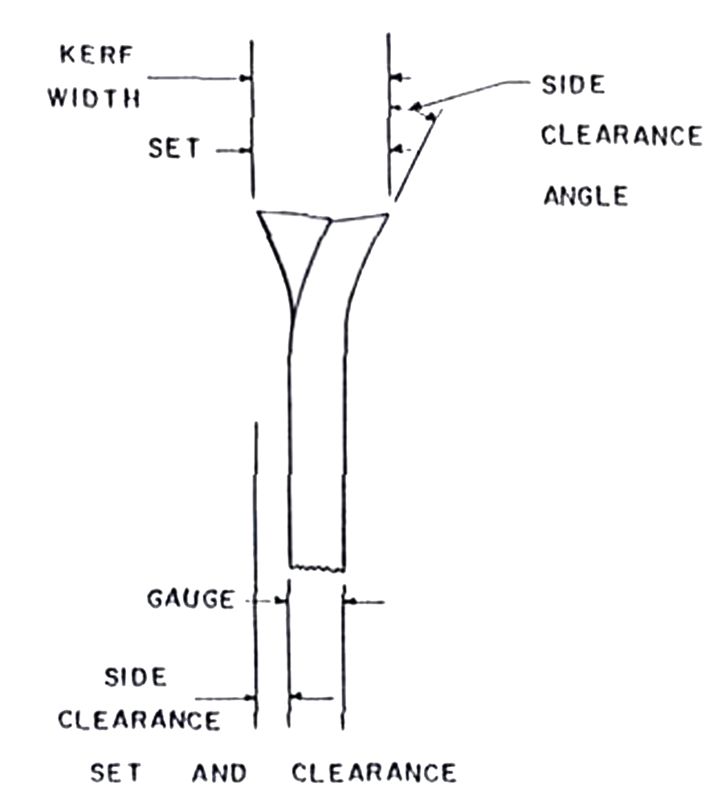
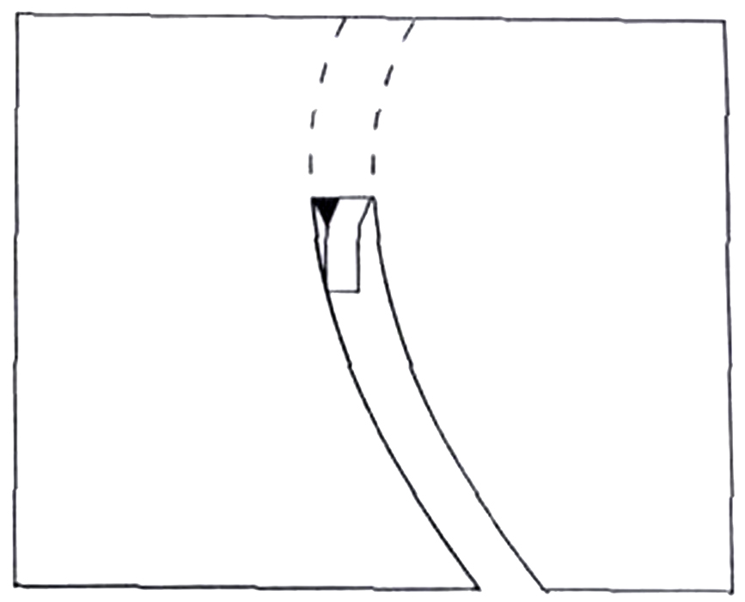
Make relief cuts to avoid pinching the blade.
The set and side clearance determines how tight a turn a bandsaw blade can make.
Turn too tight and the blade pinches which can break a blade.
Relief cuts allow pieces to fall away and not pinch the blade.
Saw Kerf

Slide 17
Stock should be flat on one side.
Watch those fingers!
It’s really difficult to hang on during a full speed spin.

Slide 18
Use a V-block when cutting round stock.
Look how simple and stable this cut can be.

Slide 19
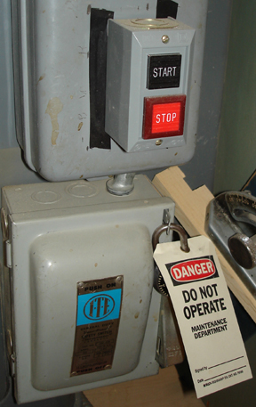
Adhere to lockout /tagout rules and procedures
Malfunctioning machines must be taken out of service and not be used.
DO NOT USE any machine that has a locked switch with a DO NOT OPERATE tag on it.

Slide 20
The End

